Slide 1
Visualizing data with TABLEAU
Our topics for this lecture
Scatter plots
Bar plots
Data over time
Heat maps, geographical maps
UNIONS and JOIN (in Tableau and R)

Slide 2
DATA SETS to USE
Datasaurus
Global superstore with multiple worksheets
Listings for Rent in NY
US ZIP Codes

Slide 3
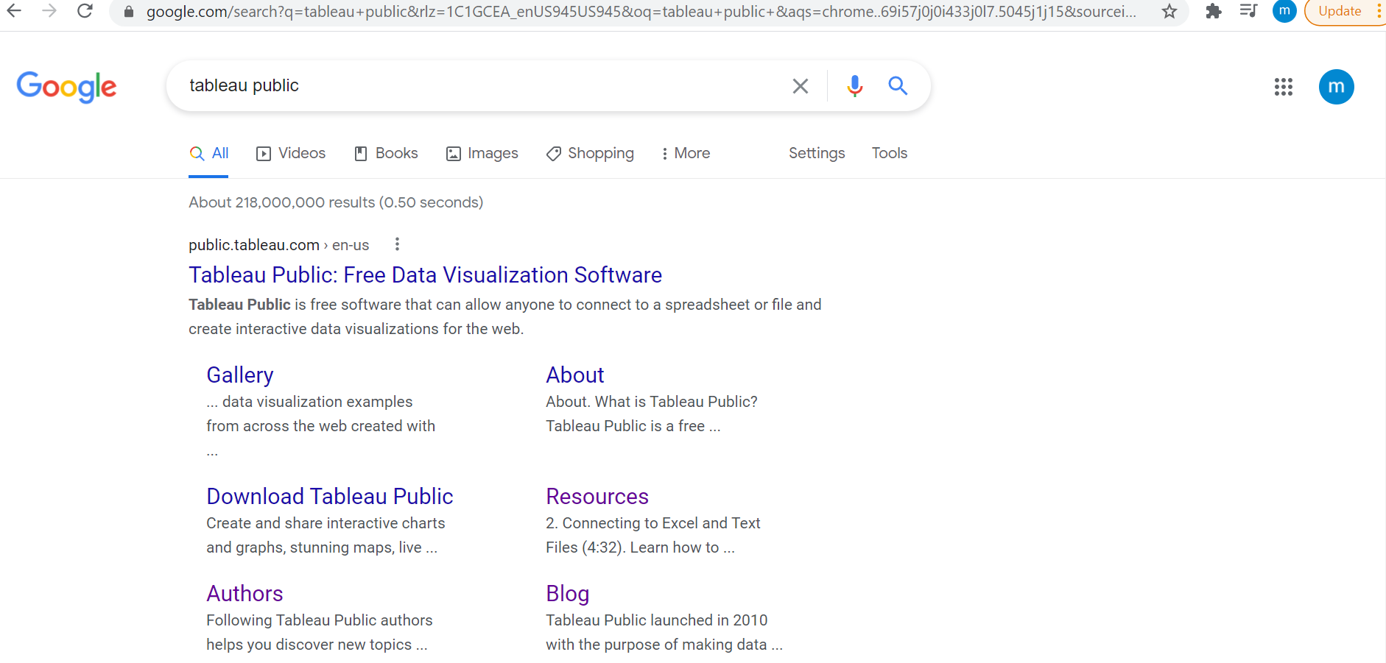
TABLEAU public
Installation

Slide 4

Add your email address

Slide 5
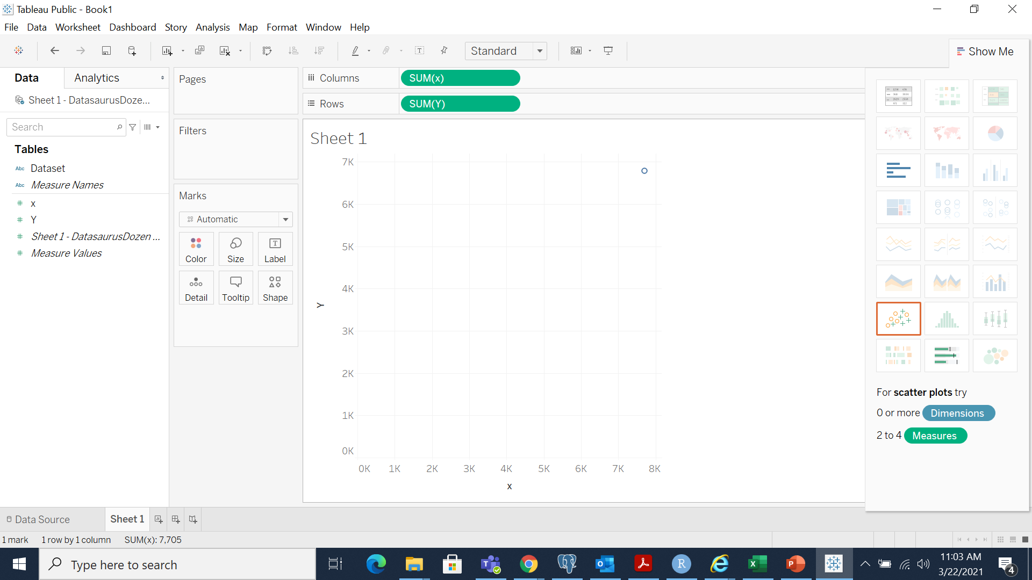
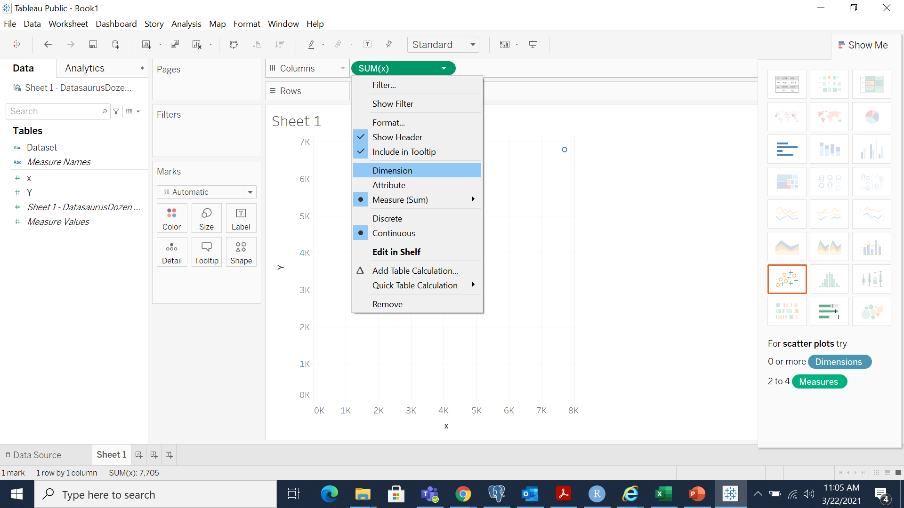
Getting started
Open Datasaurus dataset in Tableu
Use dragging to move X and Y in columns and rows in the canvas space
Sum over X and sum over y

Slide 6
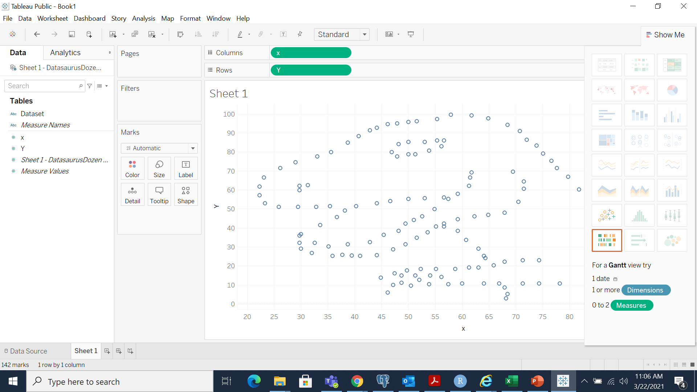
Represent the whole dataset
Scatter plots

Slide 7
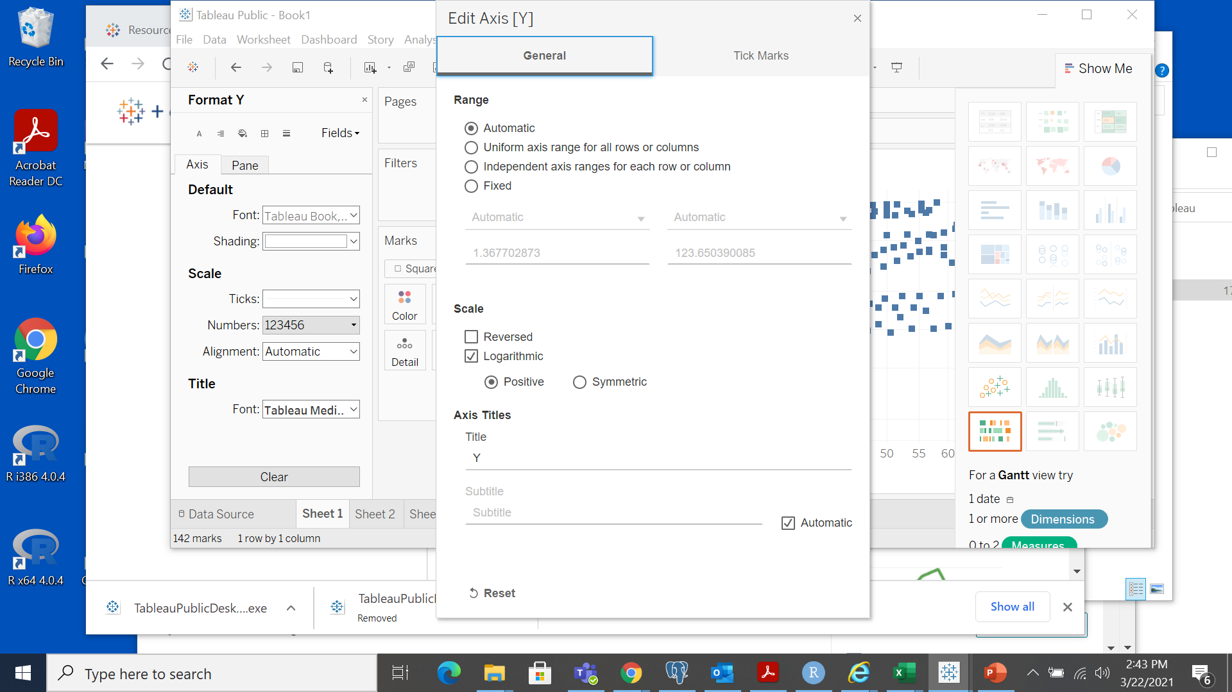
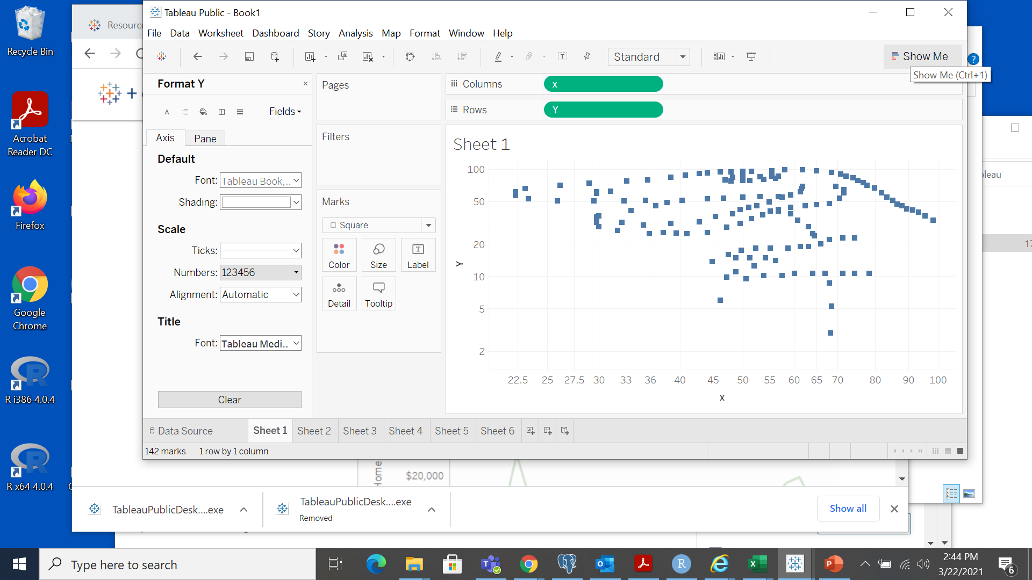
Log-Log scale
The plot shows no linear relationship between x and y

Slide 8
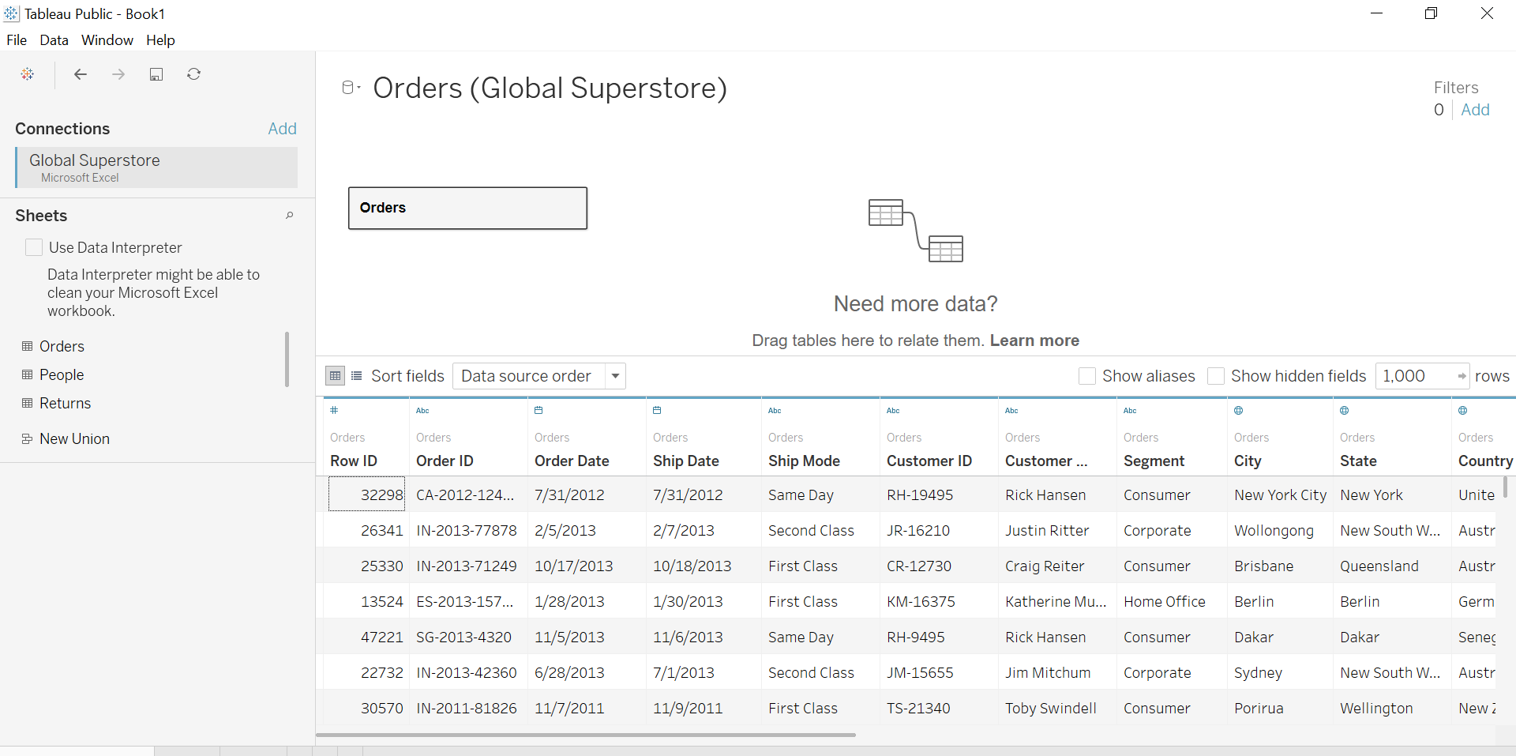
Open one worksheet from table with multiple worksheets
Open the Global Superstore dataset and drag Order data to visualize different variable

Slide 9
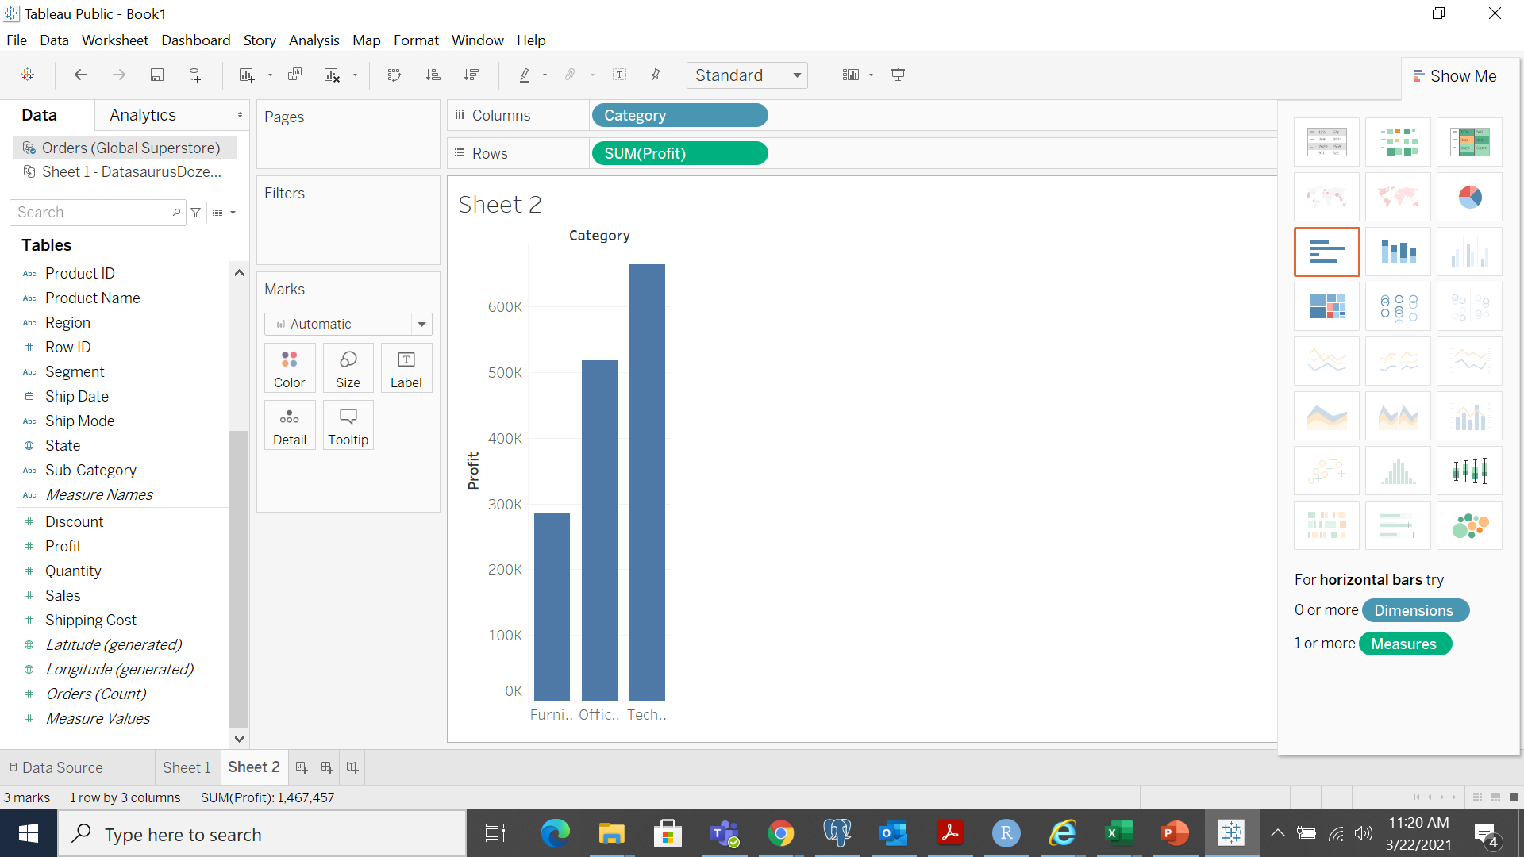
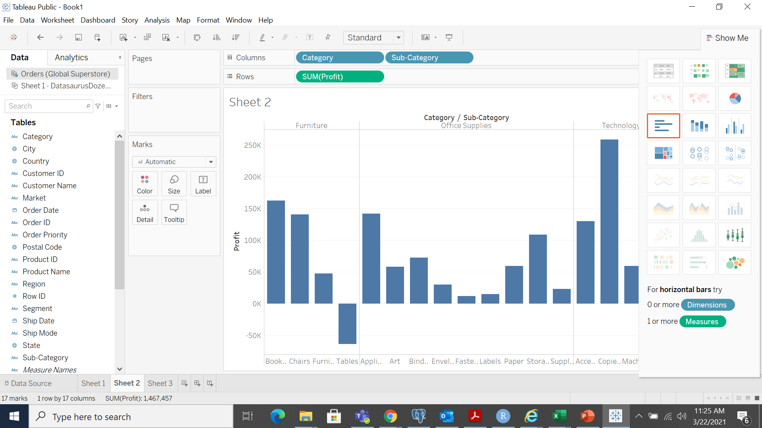
Aggregation and Granularity
We can use aggregation (or summation) only on the Measure Values
Dimensions: blue; Measures: green

Slide 10
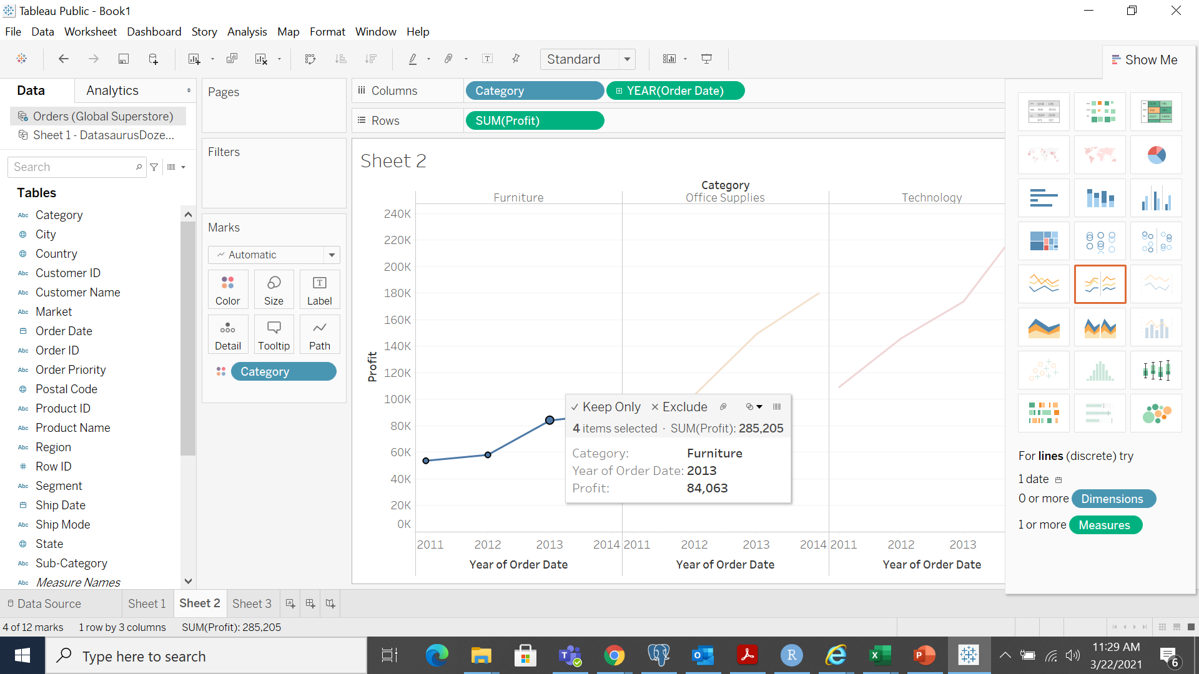
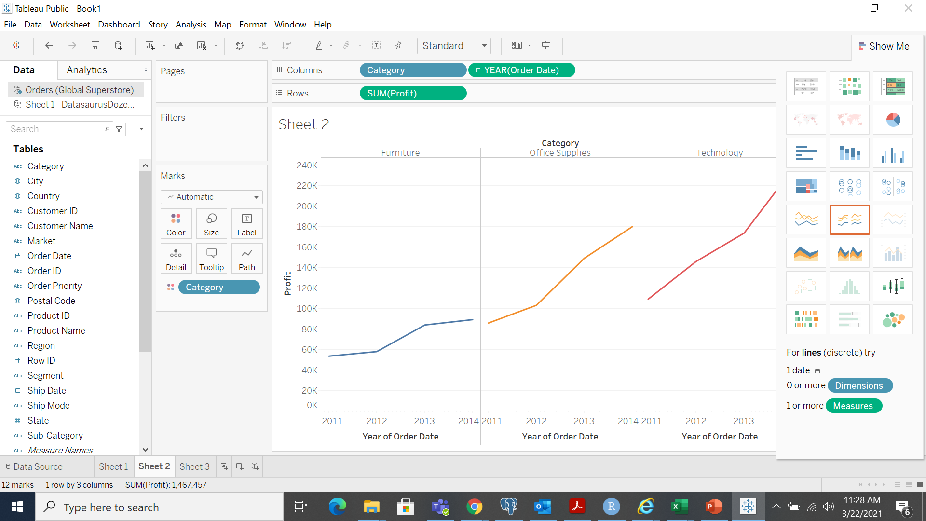
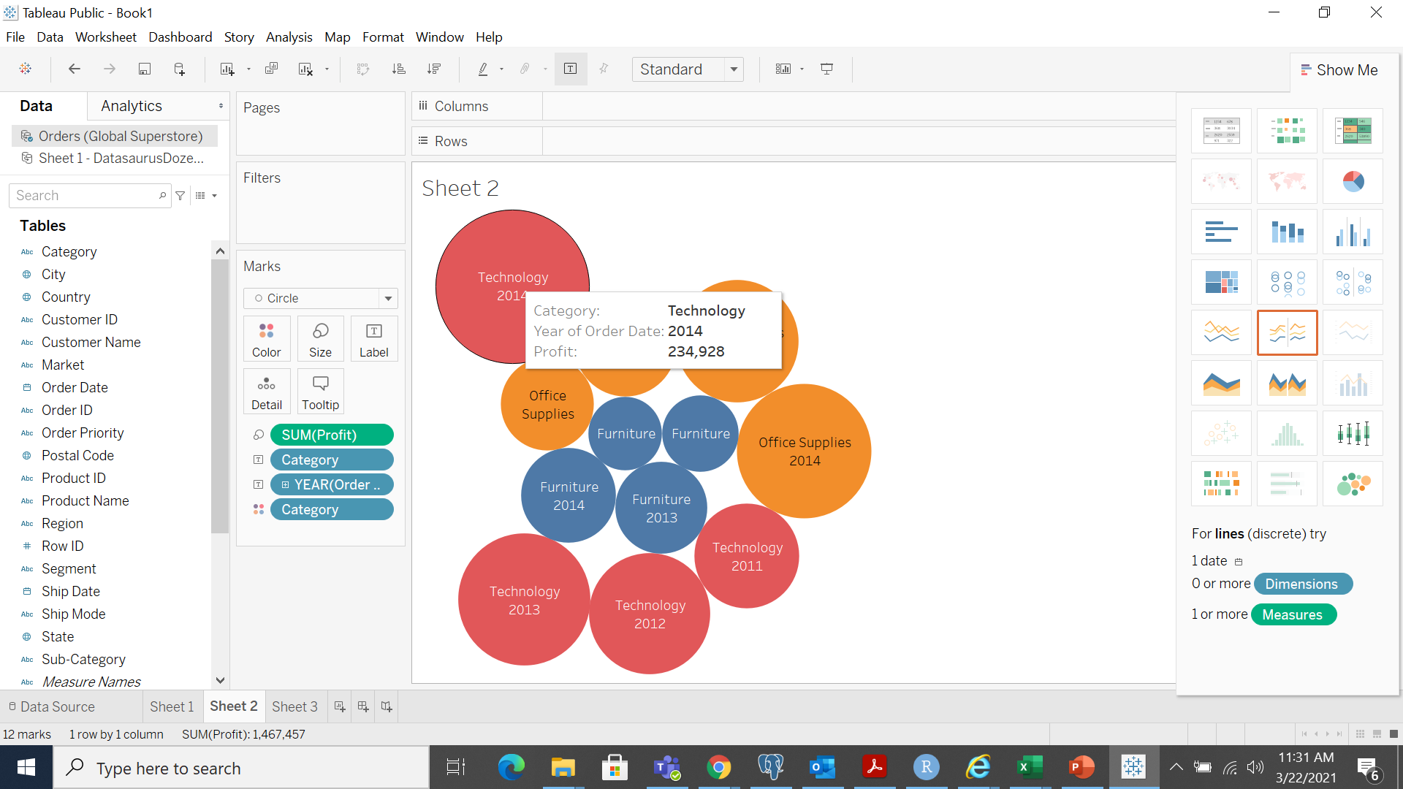
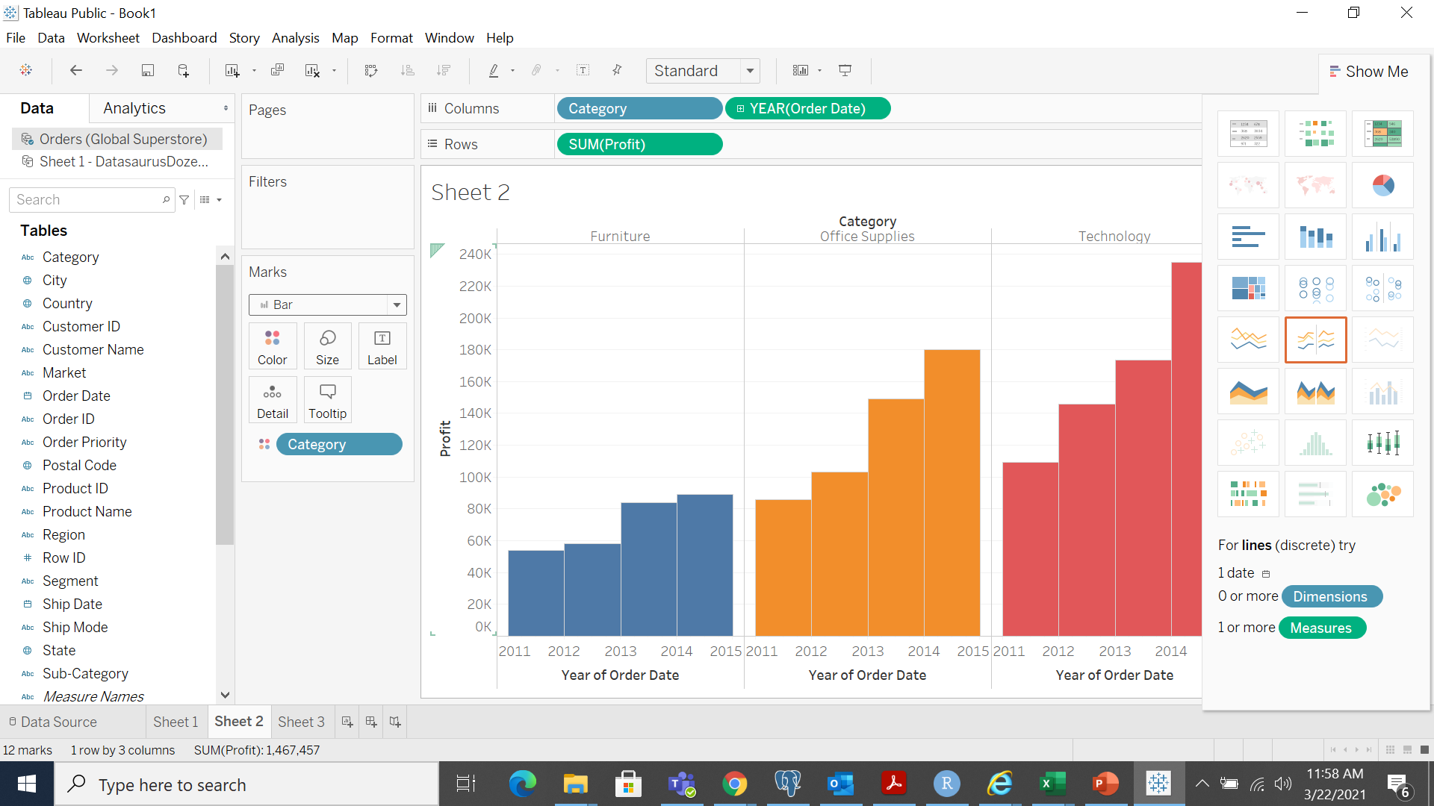

Slide 11

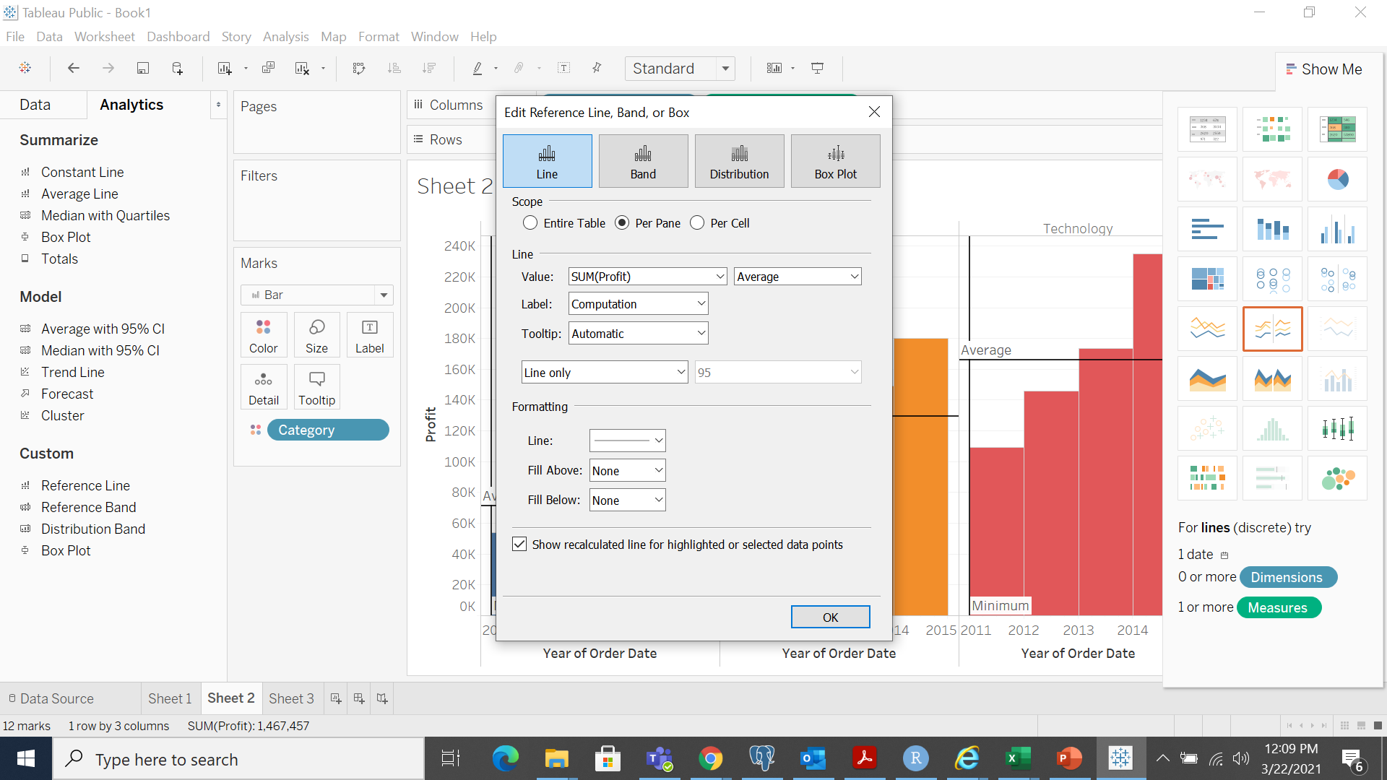
Reference line

Slide 12
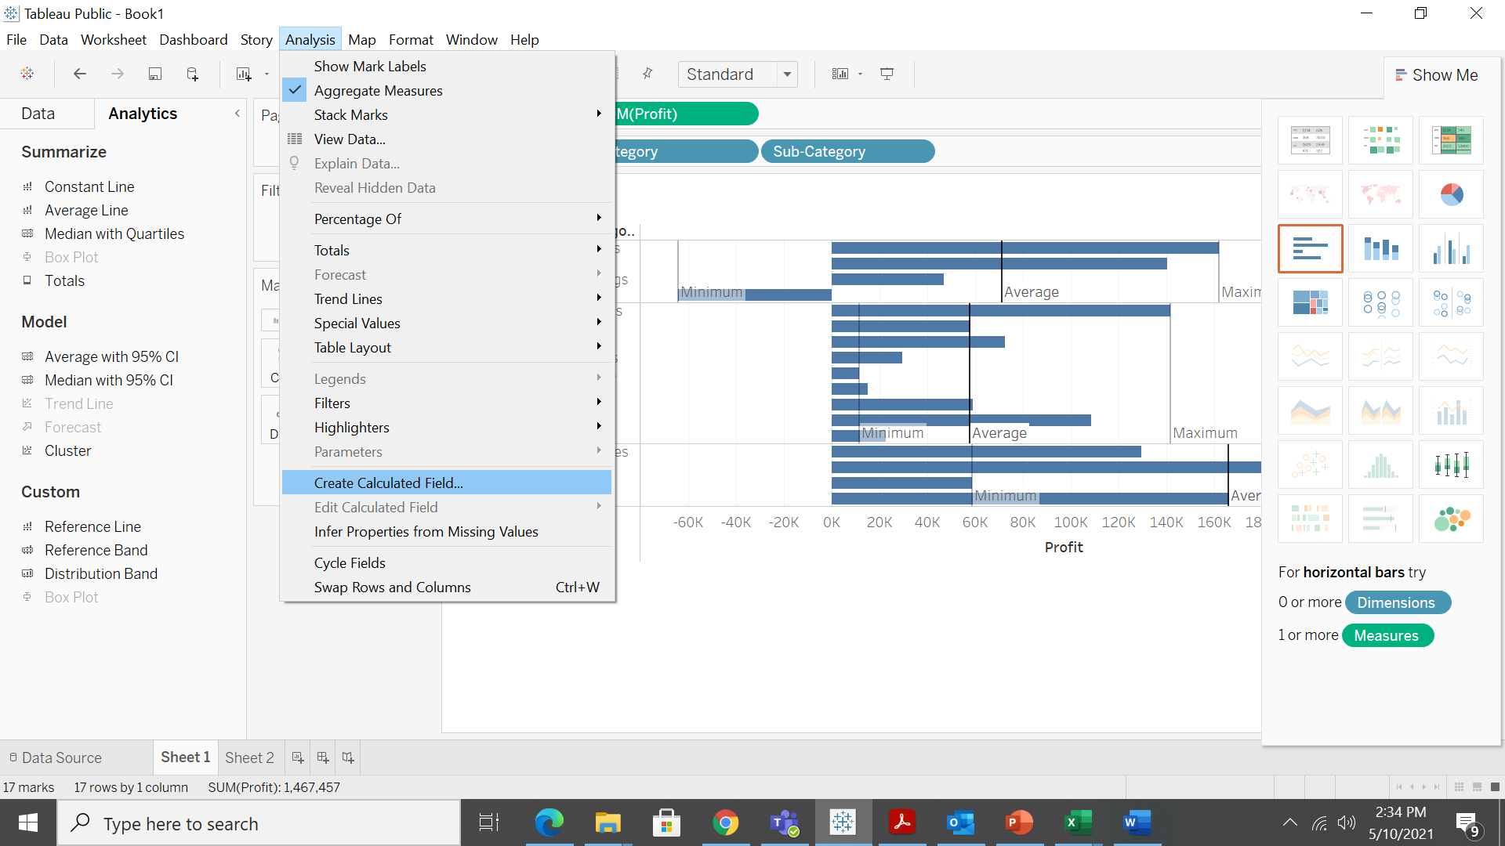
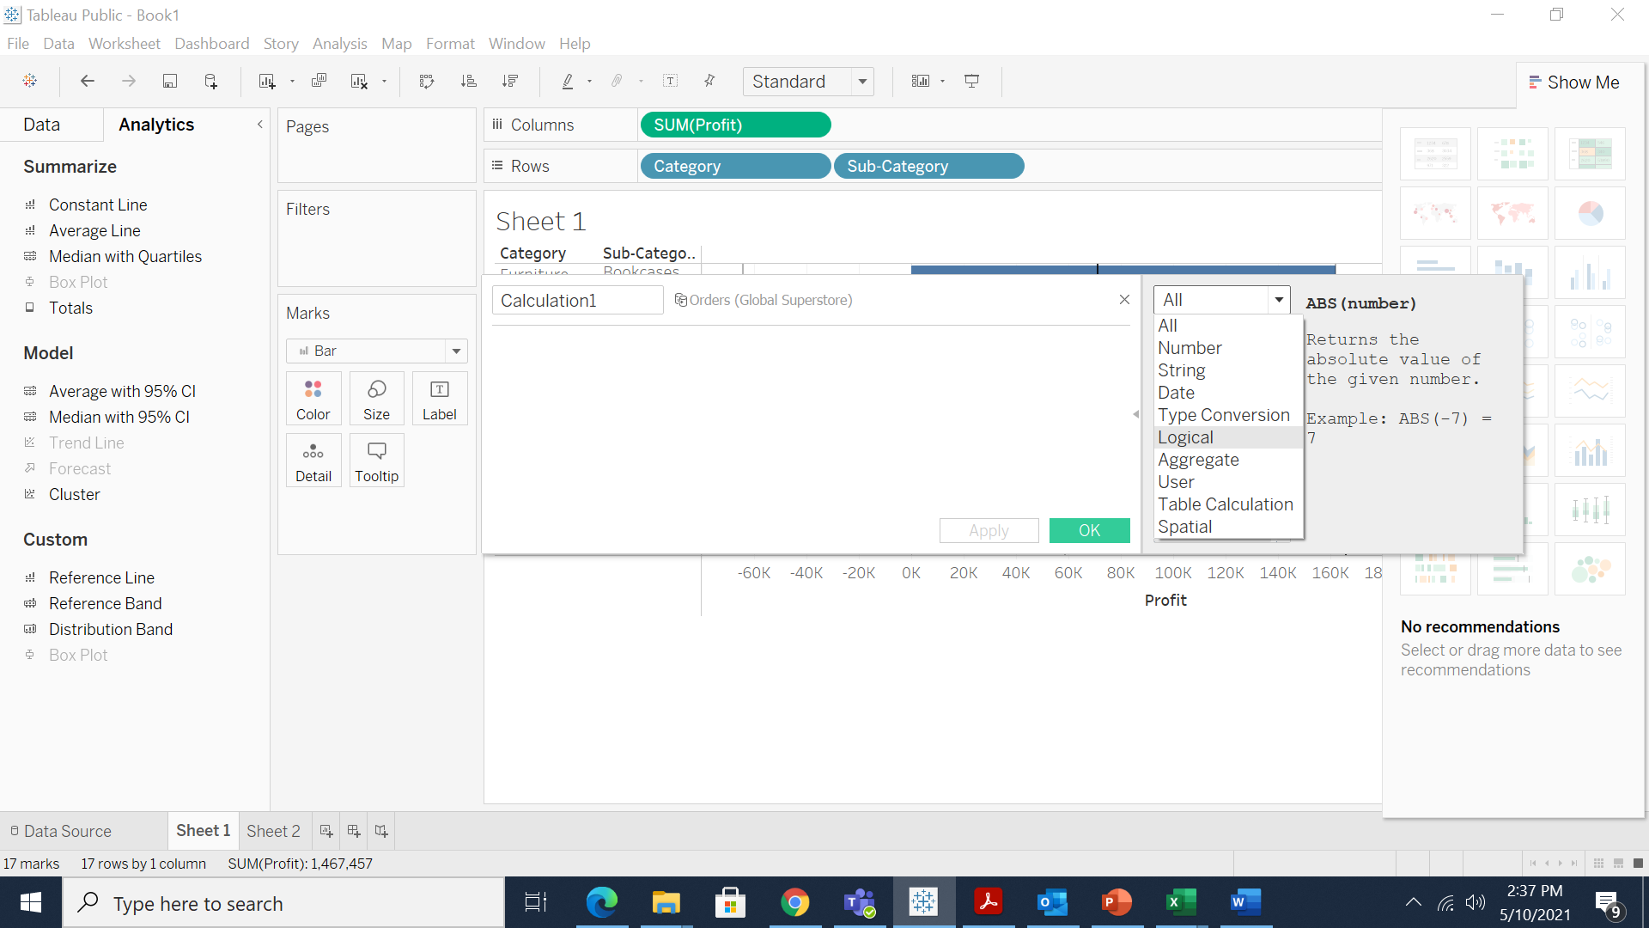
Colors with Calculated Field

Slide 13
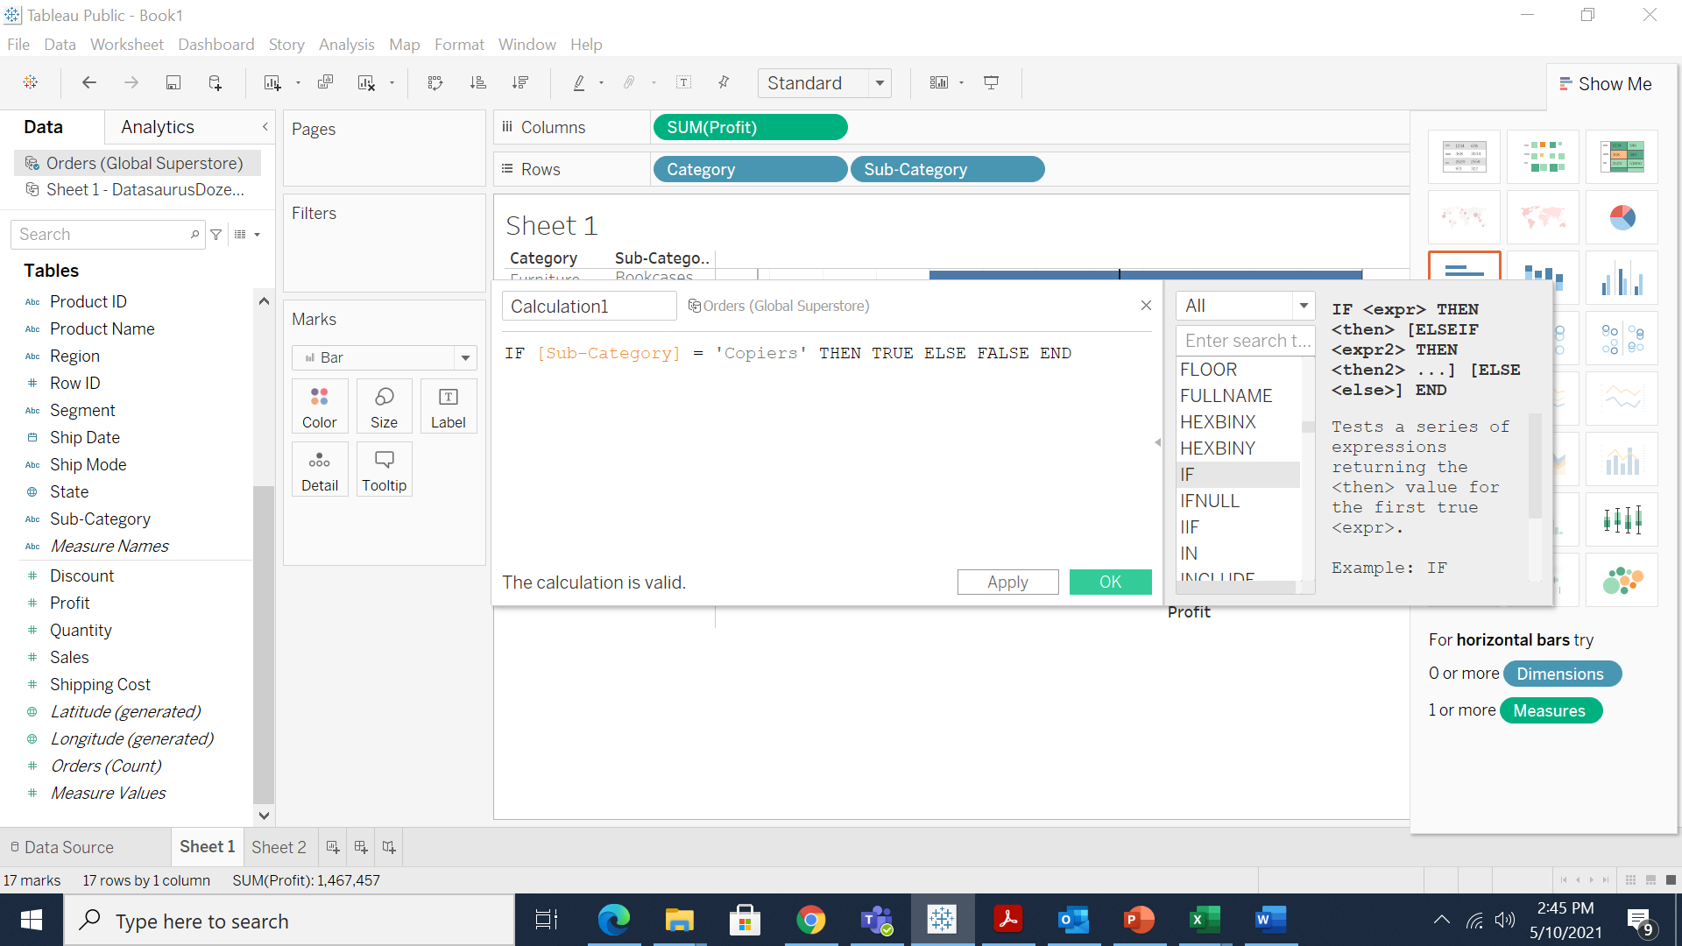
Colors with Calculated Field

Slide 14
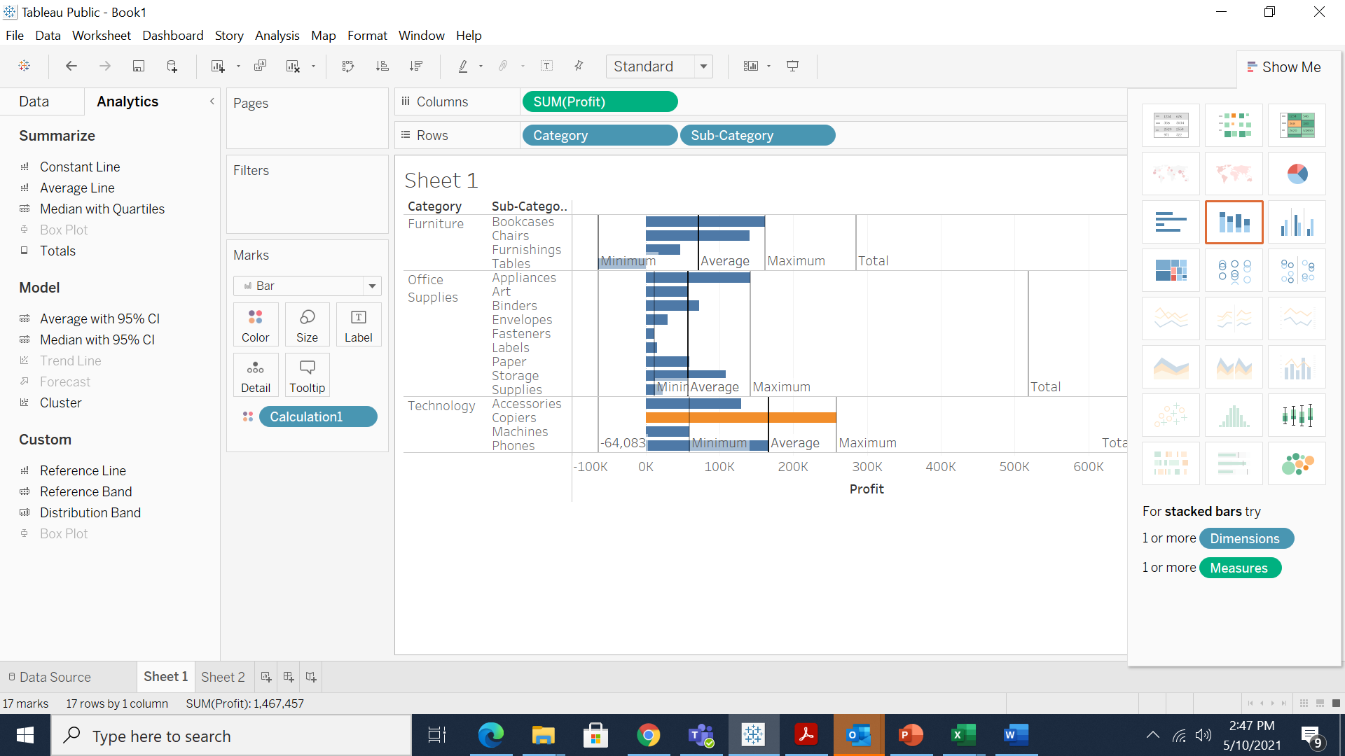
Colors with Calculated Field

Slide 15
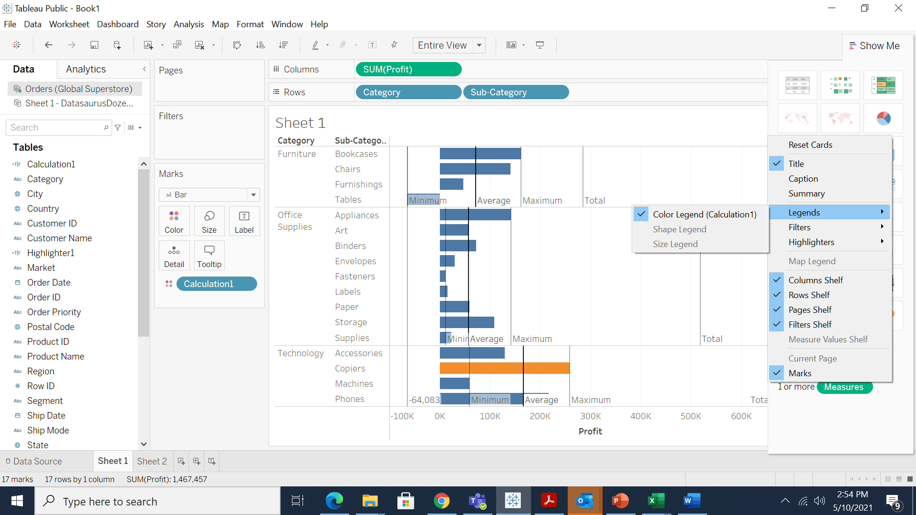
Colors with Calculated Field

Slide 16
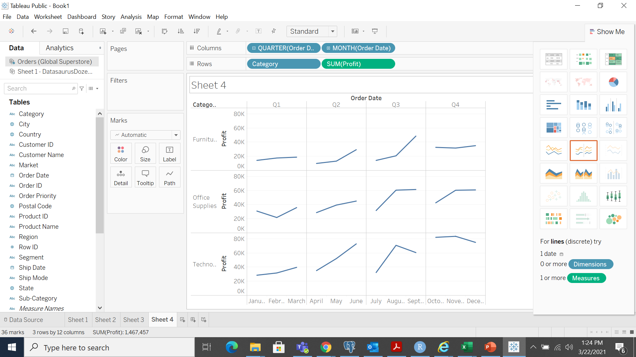
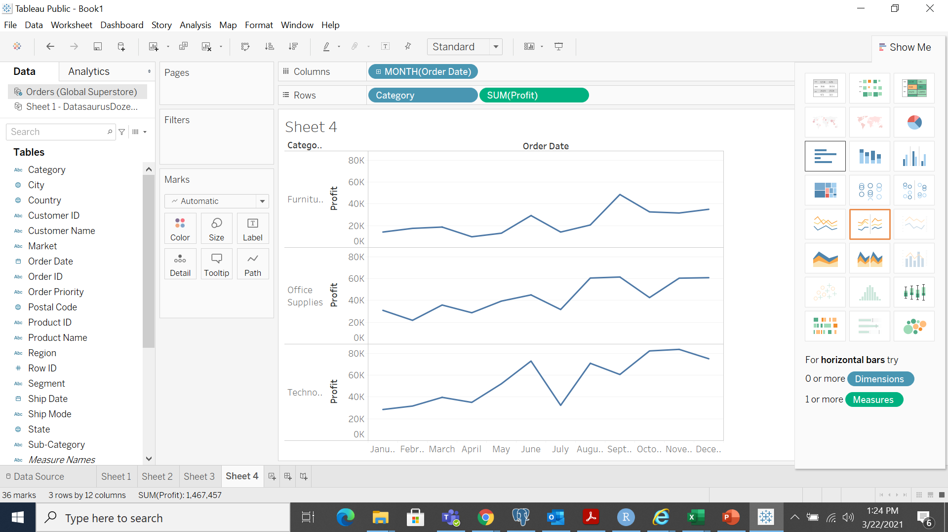
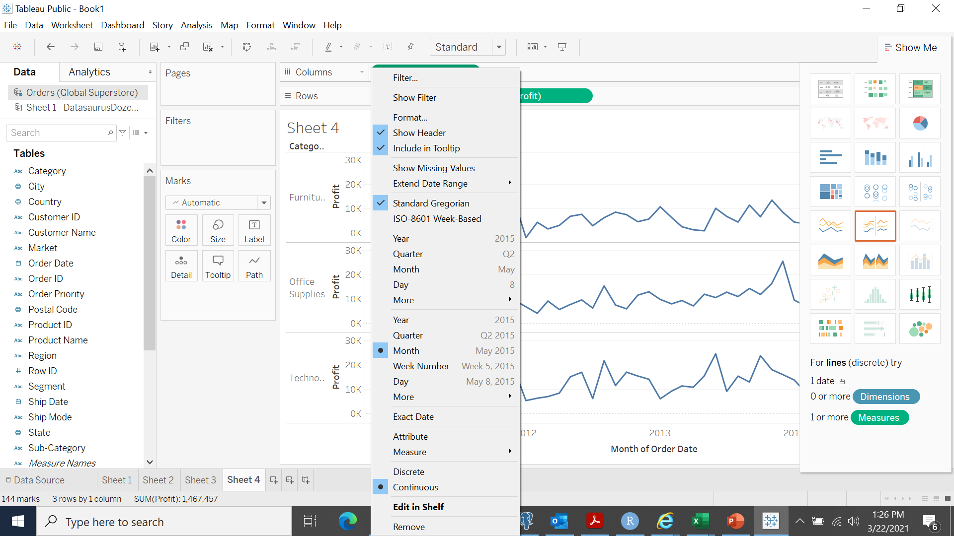
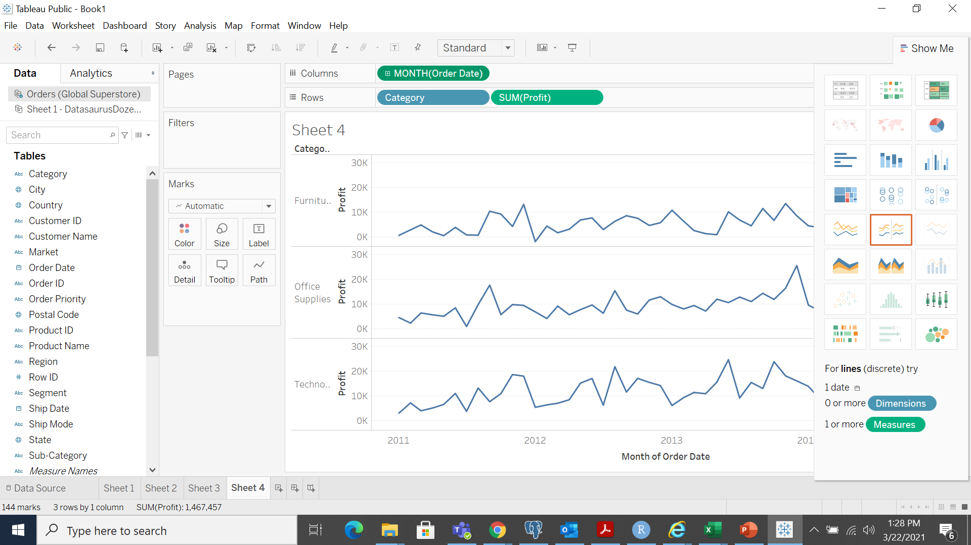
Data over time

Slide 17
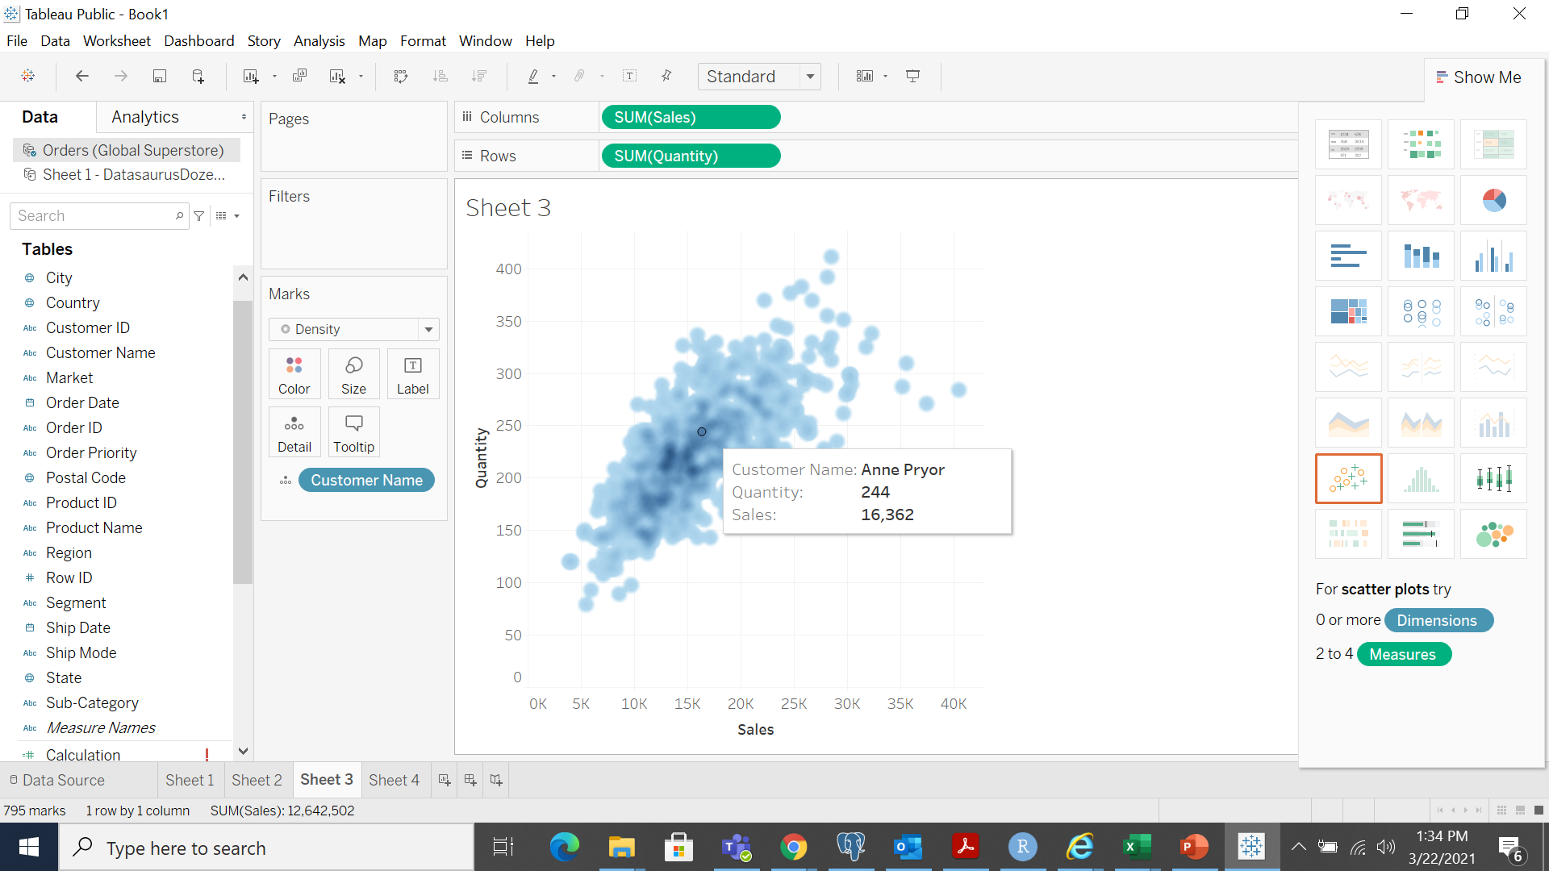
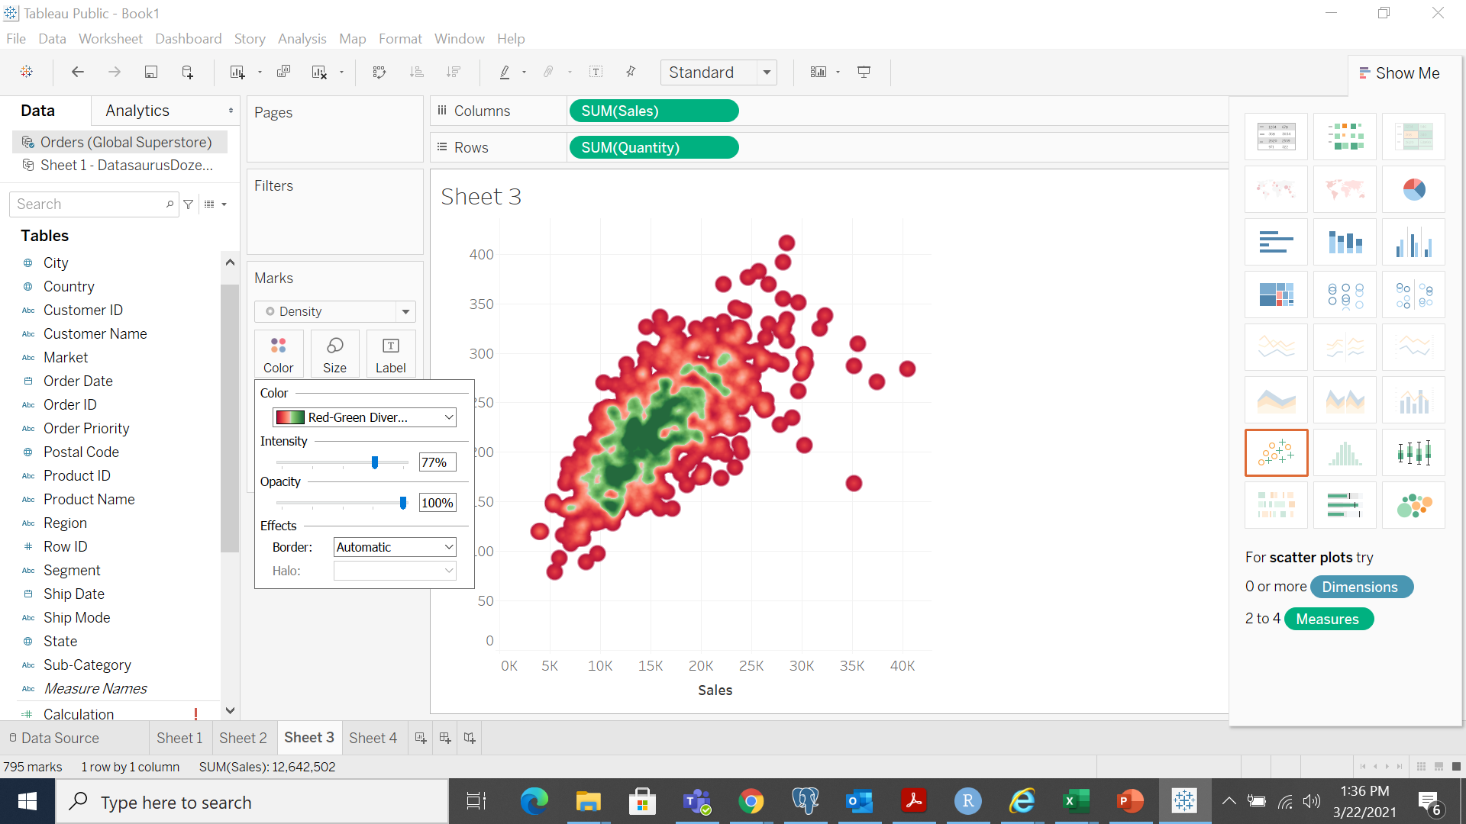
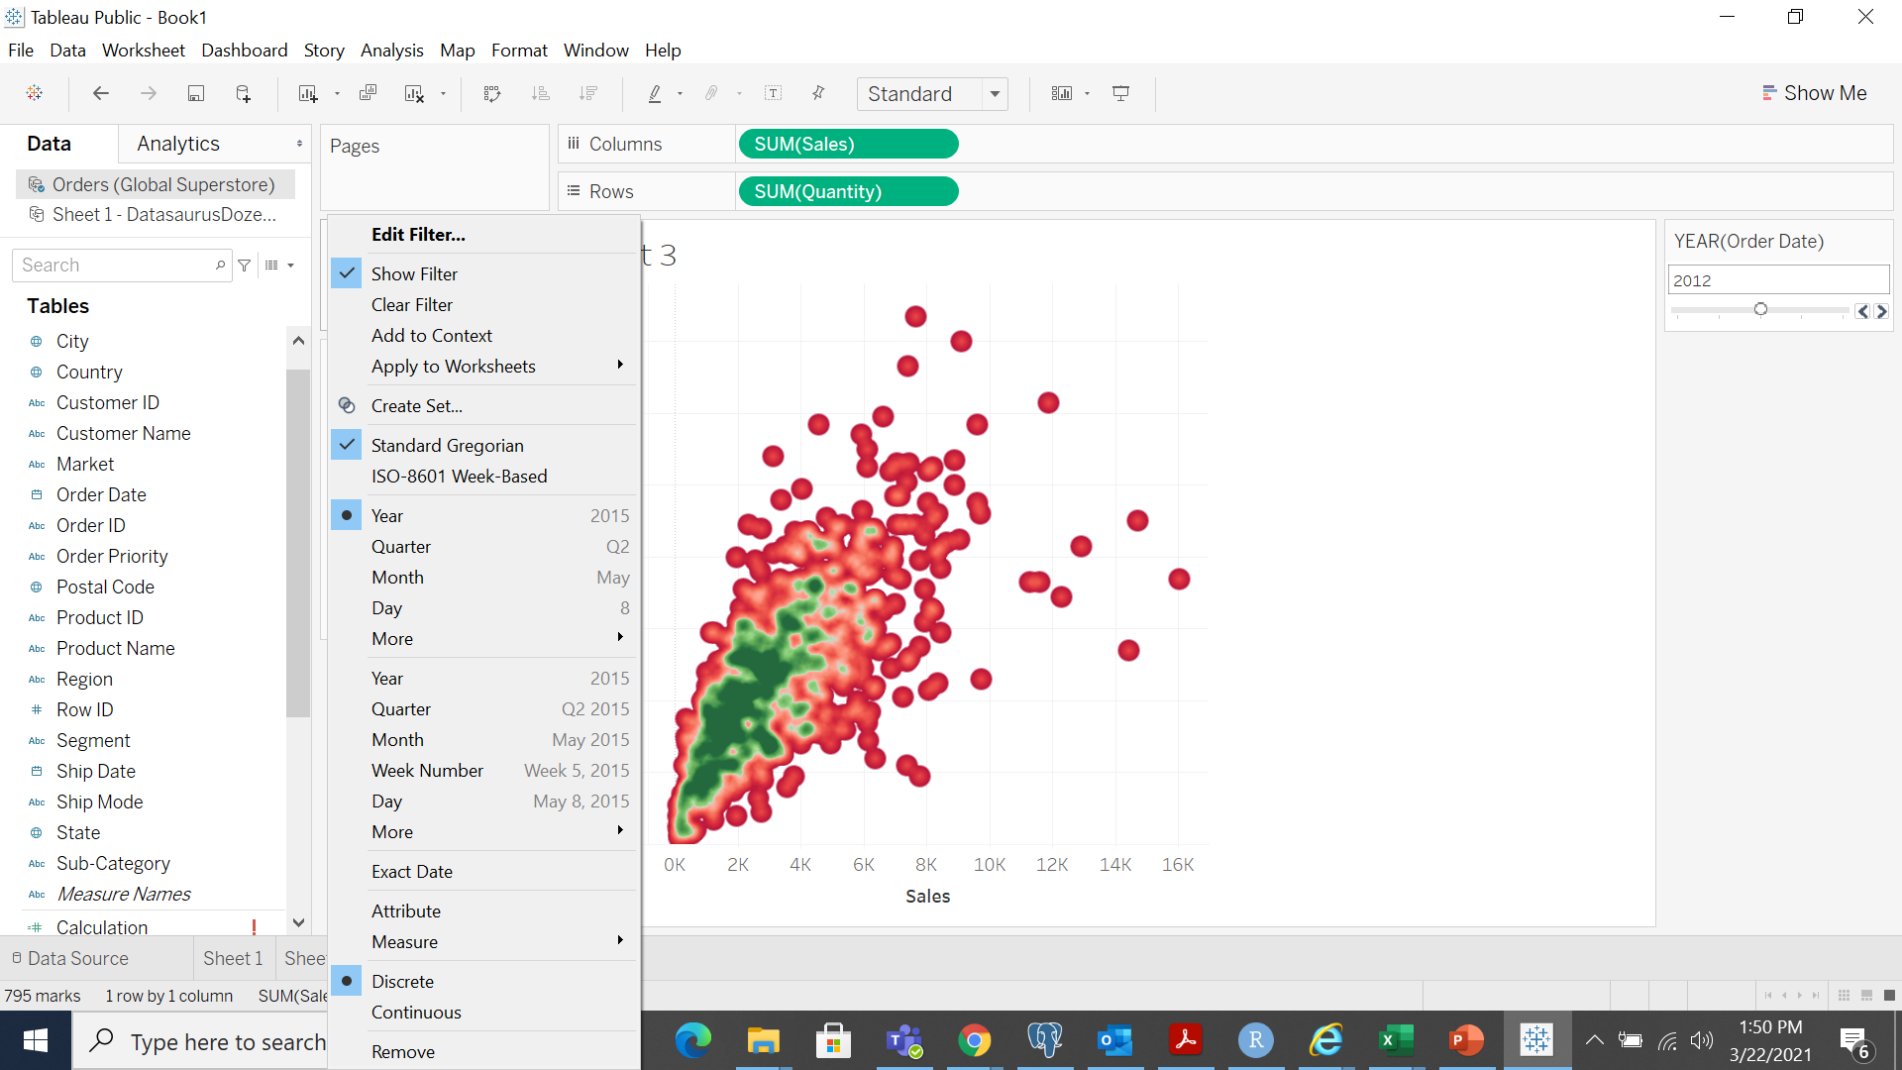
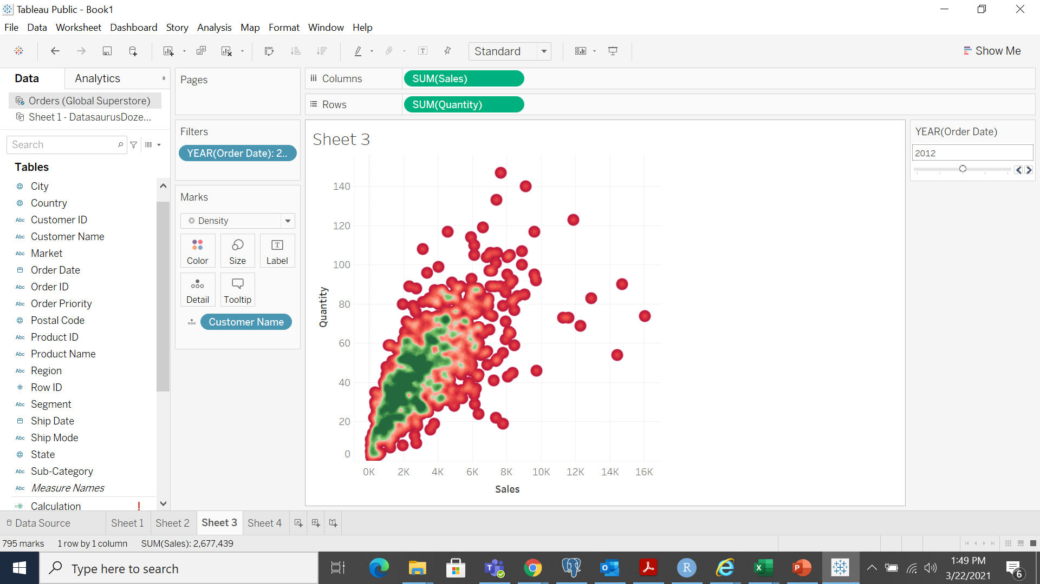
Heat maps

Slide 18
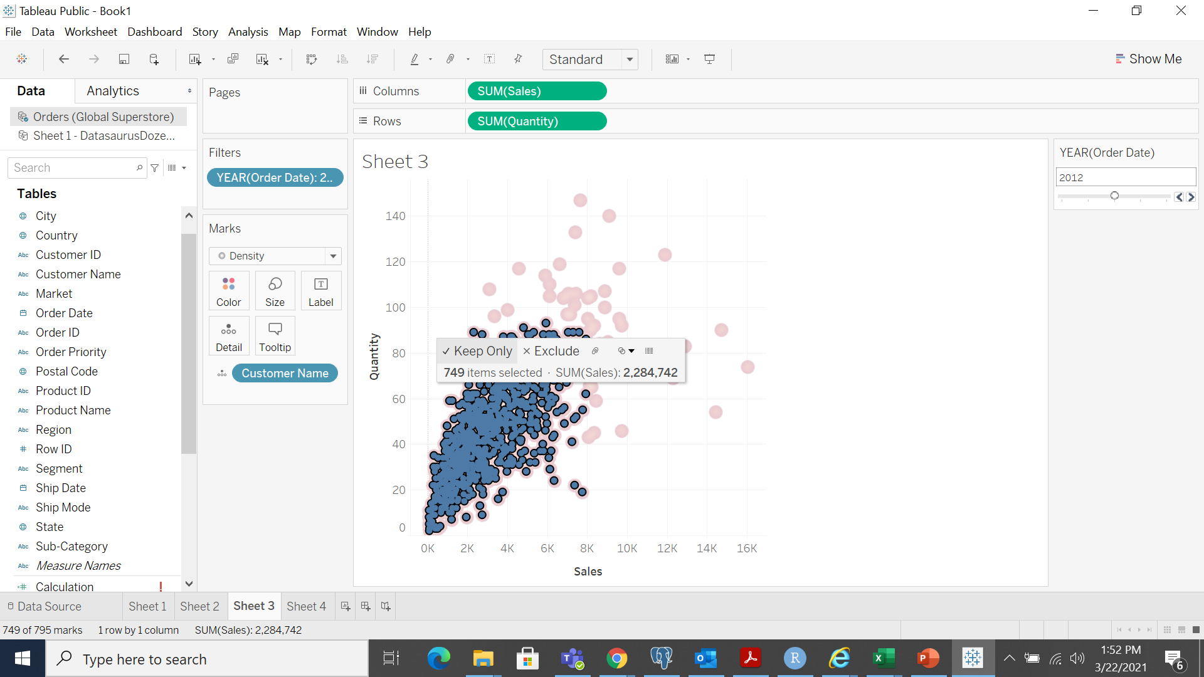
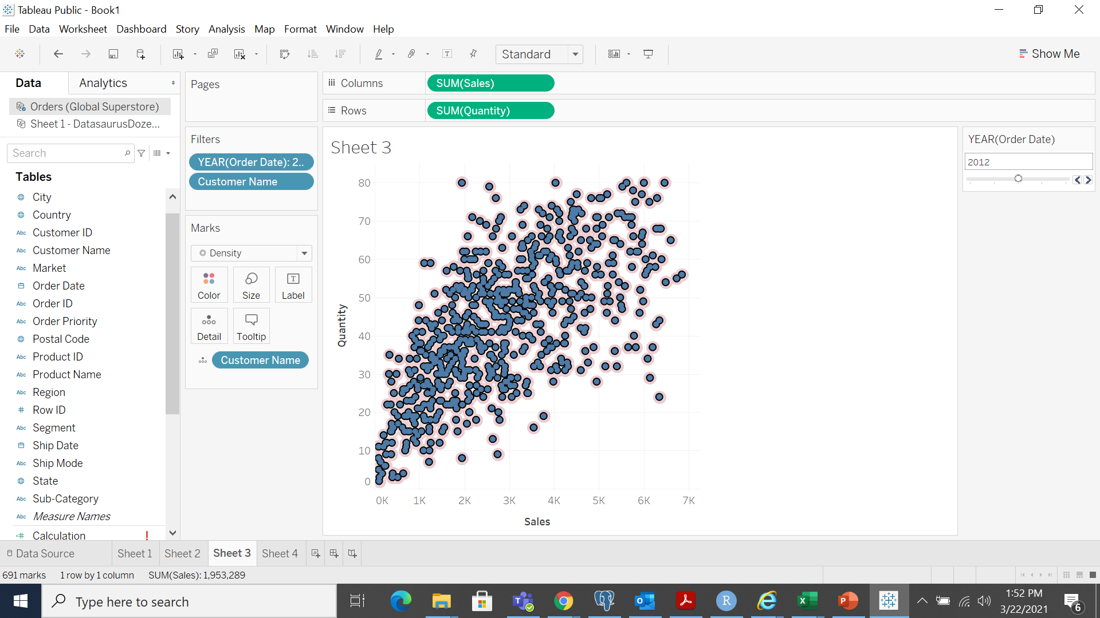
Heat maps
Exclude outliers by selecting the points in the cluster

Slide 19
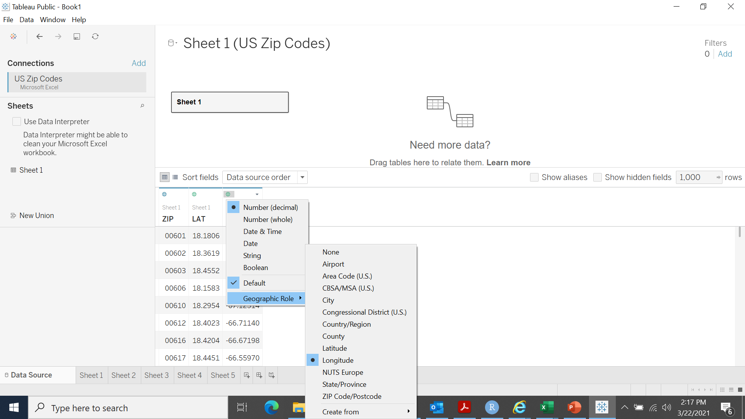
Represent the zip codes of US on the geographical map

Slide 20
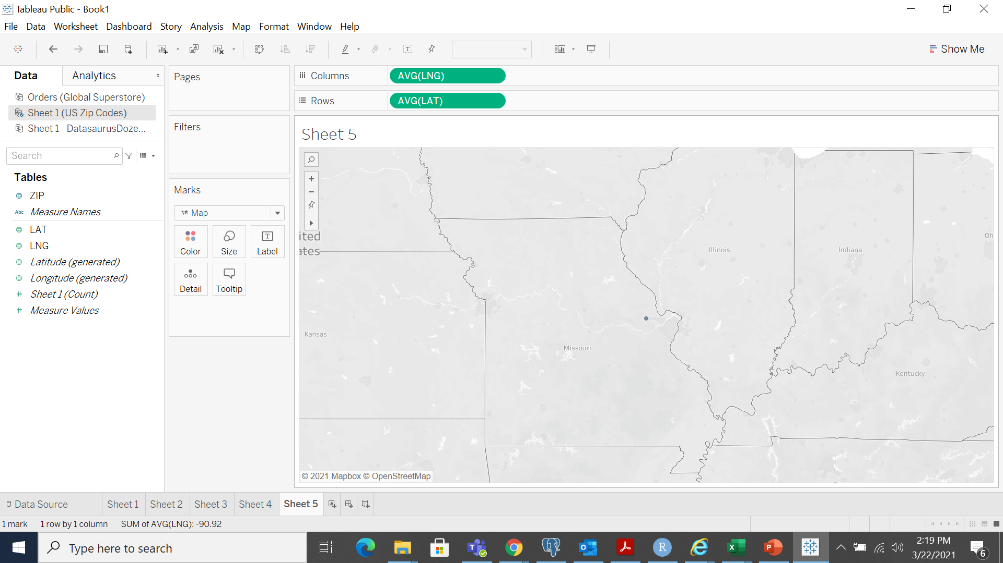
Display each zip code on the map

Slide 21
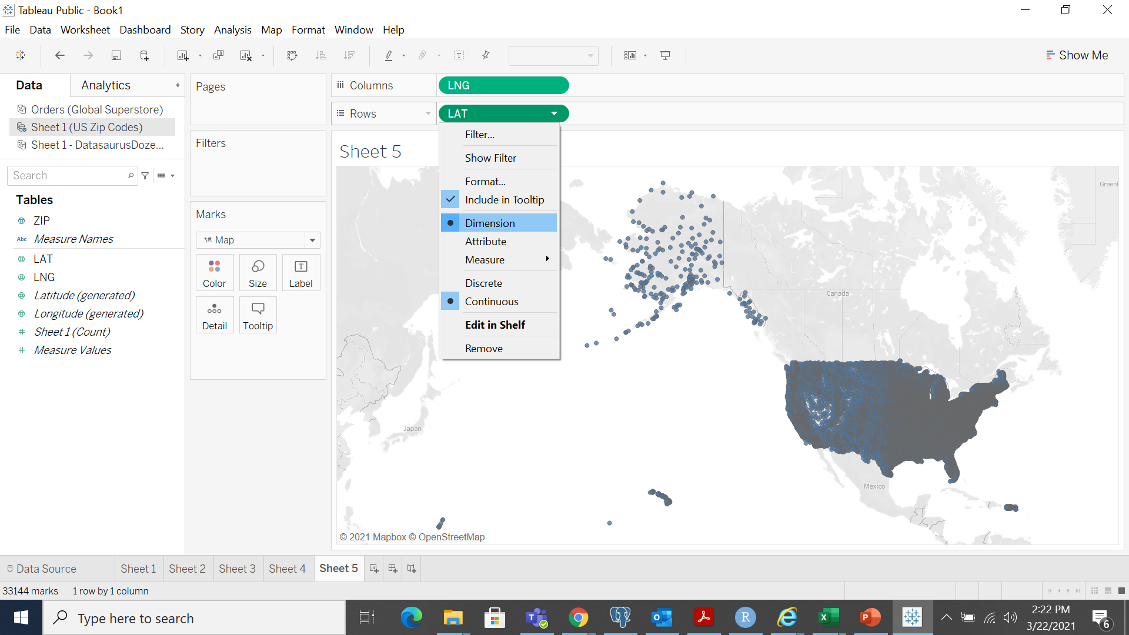
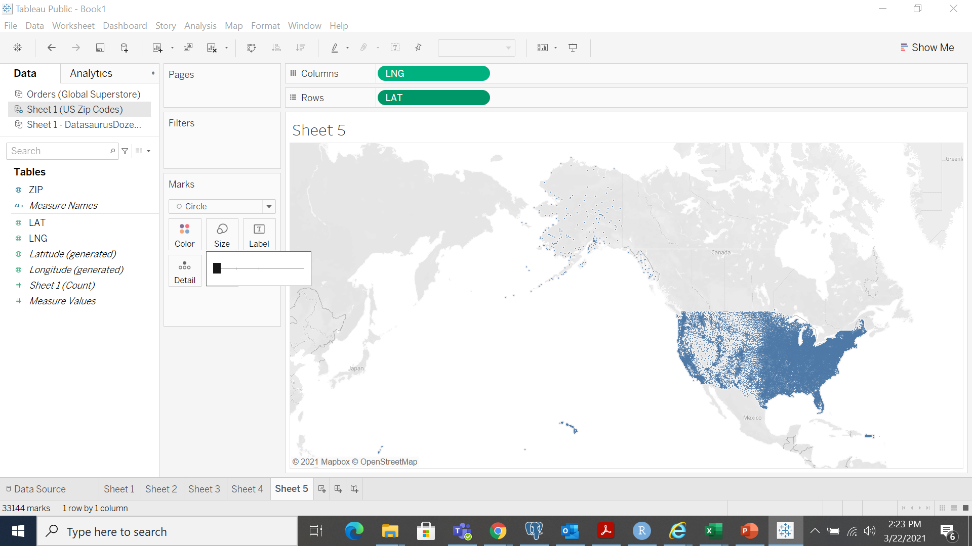
See more details with Dimensions

Slide 22
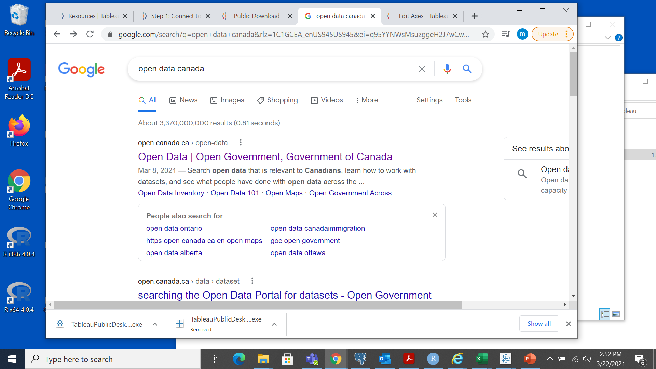
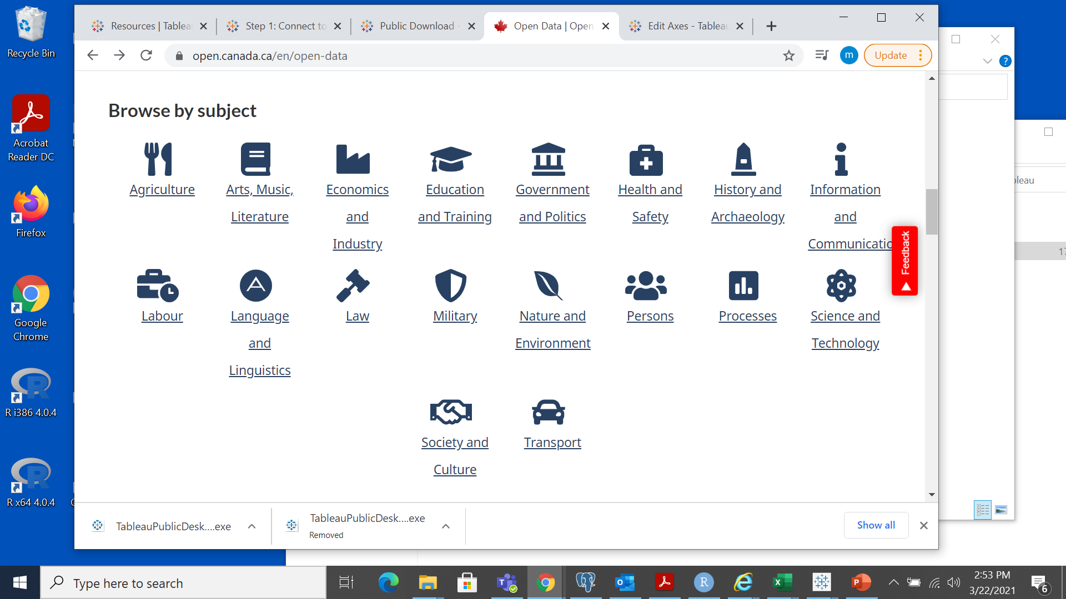
Open DATA

Slide 23
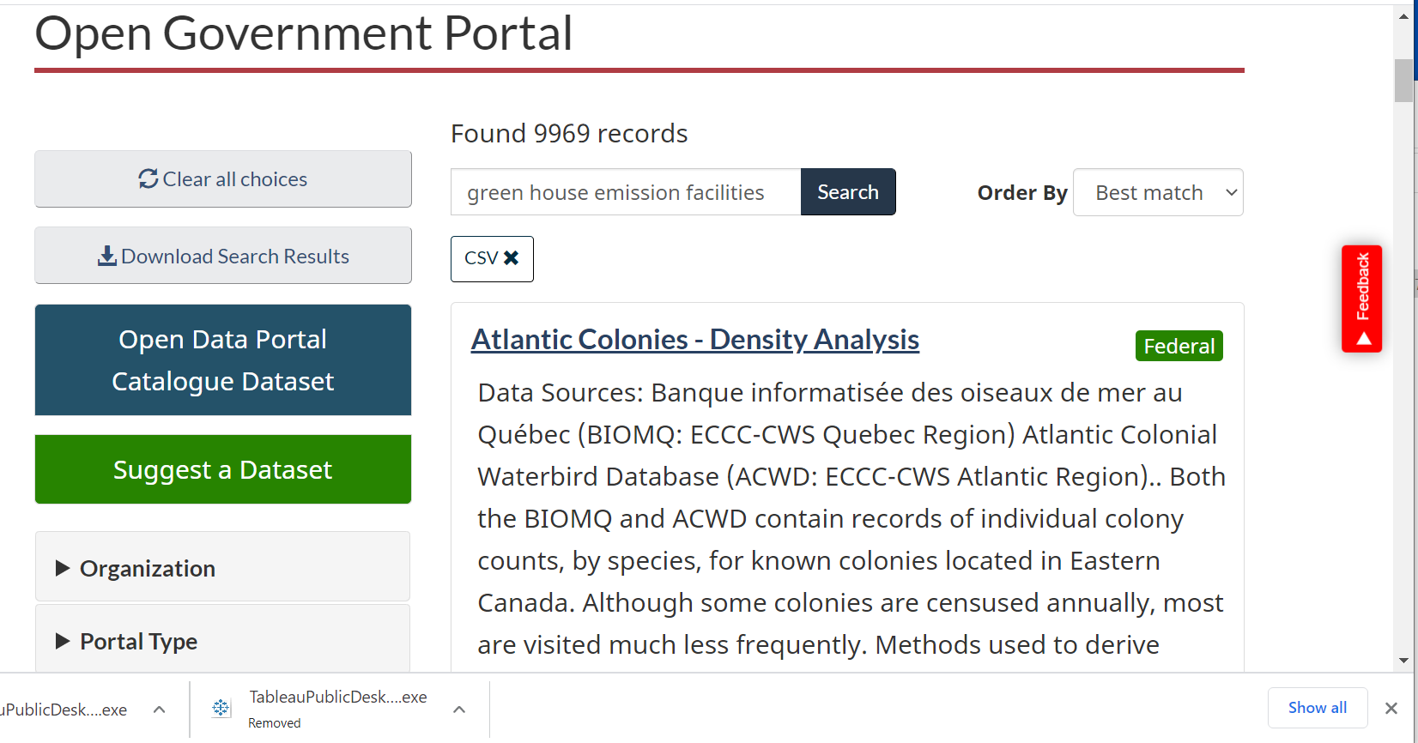

Slide 24
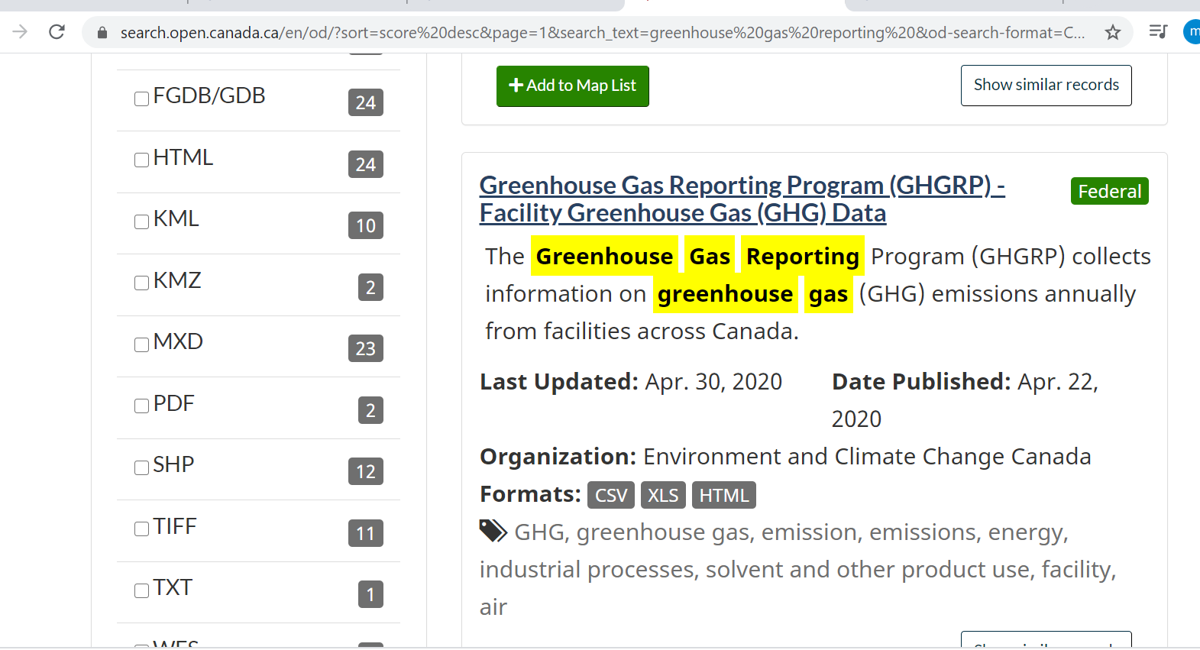
https://open.canada.ca/data/en/dataset/a8ba14b7-7f23-462a-bdbb-83b0ef629823

Slide 25
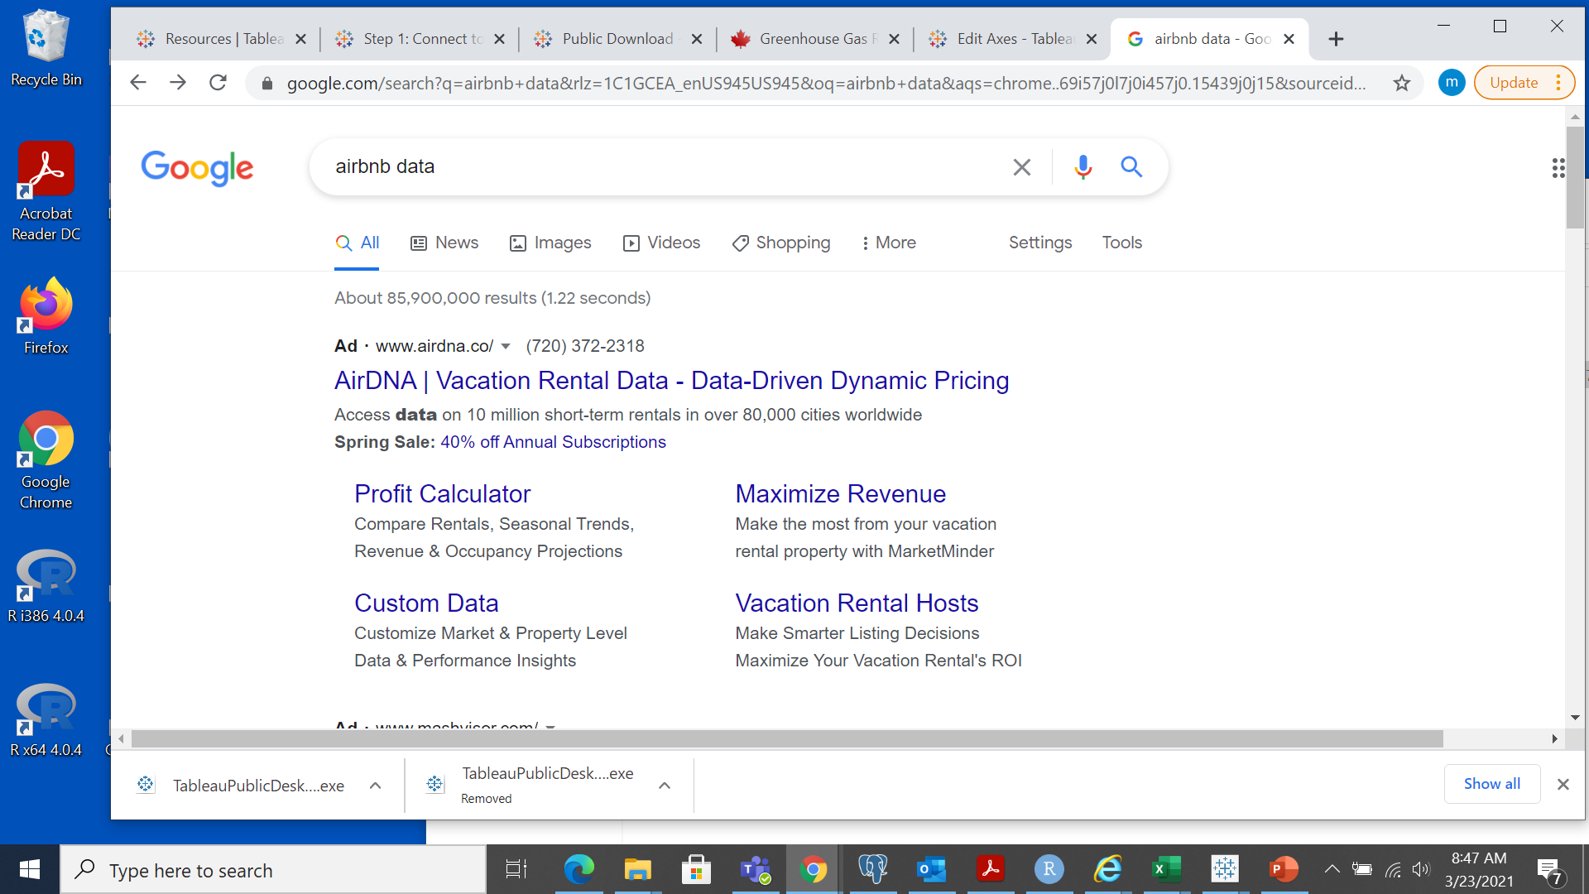
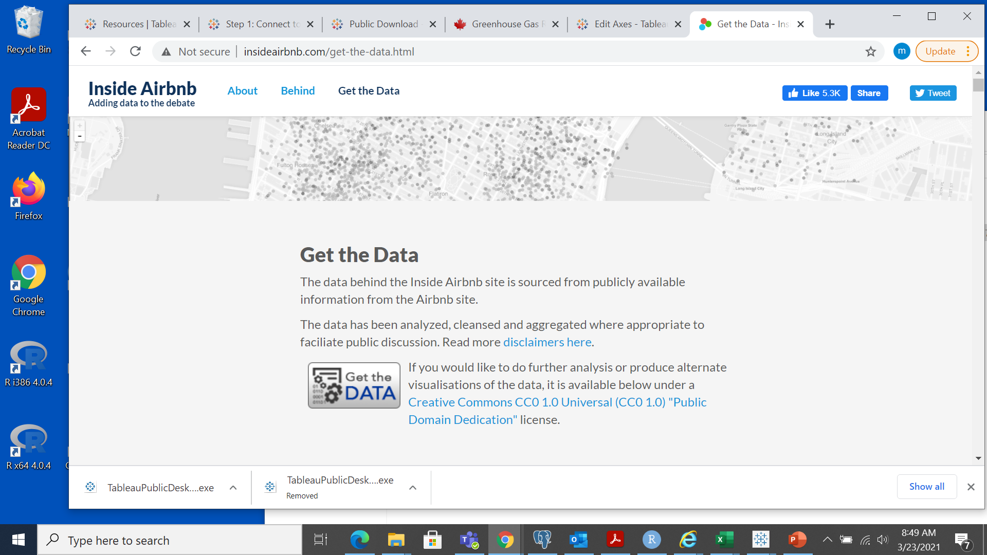
Get more data
We are interested in New York data.
And what are the best places to
rent.

Slide 26
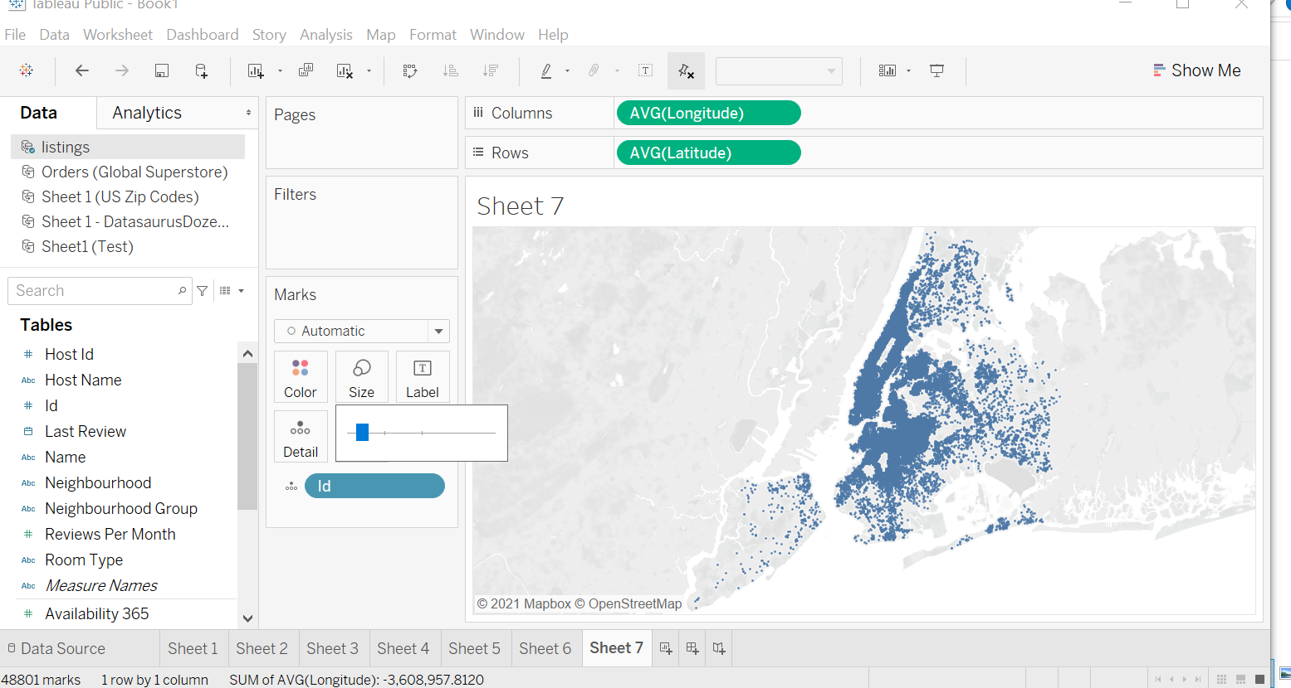

Slide 27
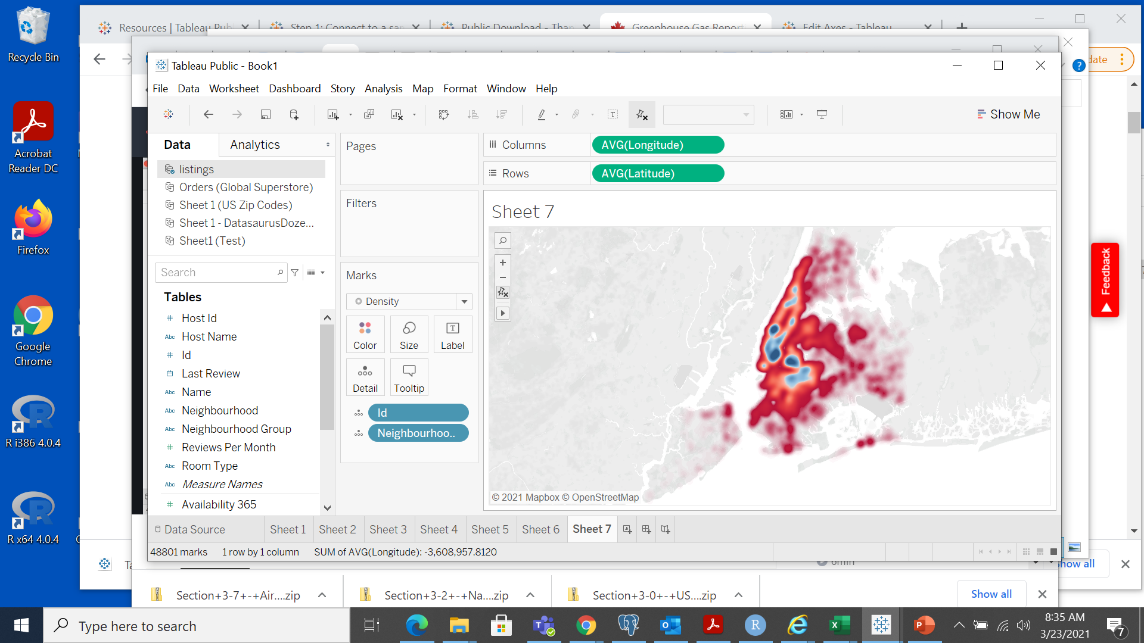
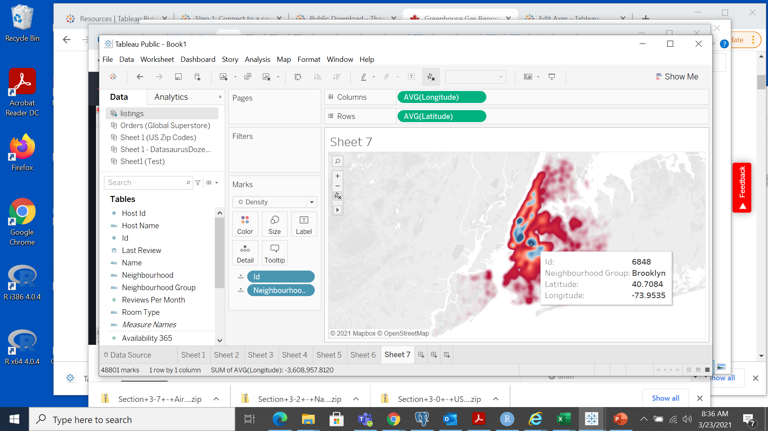

Slide 28
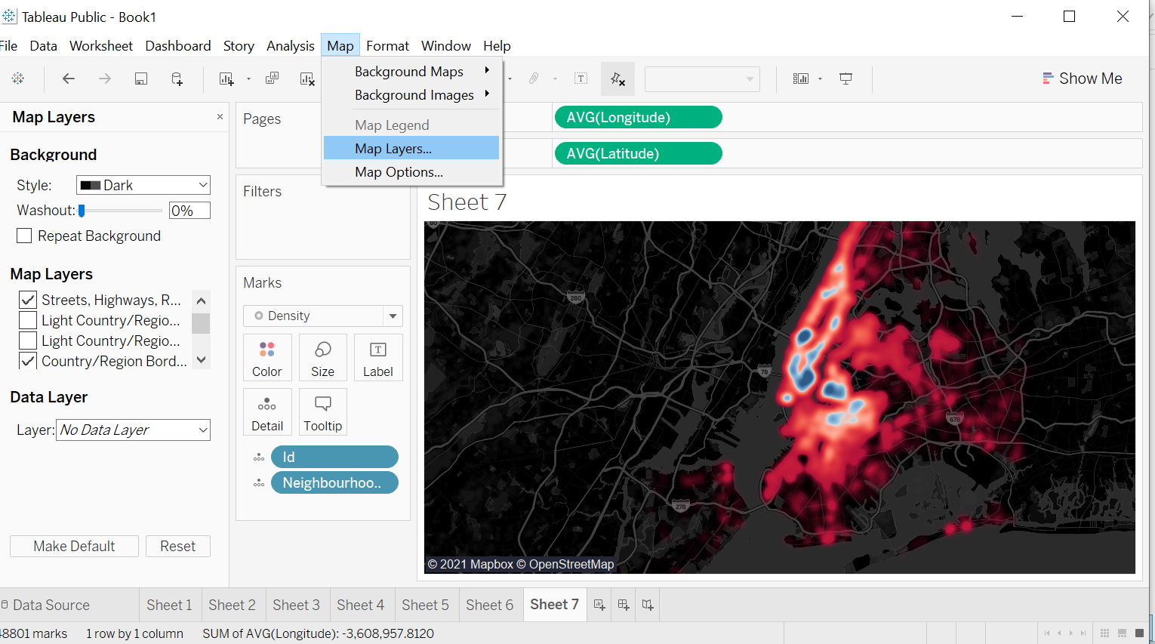
Density plot

Slide 29
UNIONS AND JOIN
Open the Global Superstore data
Drag the first table (Orders) to the canvas
Select open from the menu or double-click the first table to open
the join canvas
Double-click or drag another table to the join canvas
Click the join icon to configure the join.
https://help.tableau.com/current/pro/desktop/en-us/joining_tables.htm

Slide 30
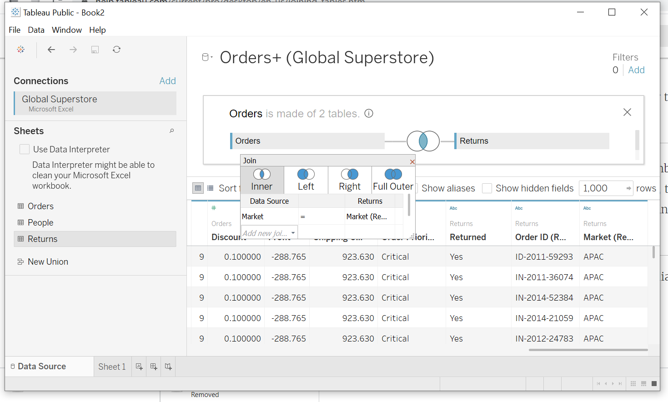

Slide 31
Join and Union with R
https://hollyemblem.medium.com/joining-data-with-dplyr-in-r-874698eb8898
https://dplyr.tidyverse.org/reference/join.html
Using dplyr within R, we can easily import our data and join these tables, using the following join types.
Inner Join (inner_join)
Left Join (left_join)
Right Join (right_join)
Full Join (full_join)
Semi Join (semi_join)
Anti Join (anti_join)

Slide 32
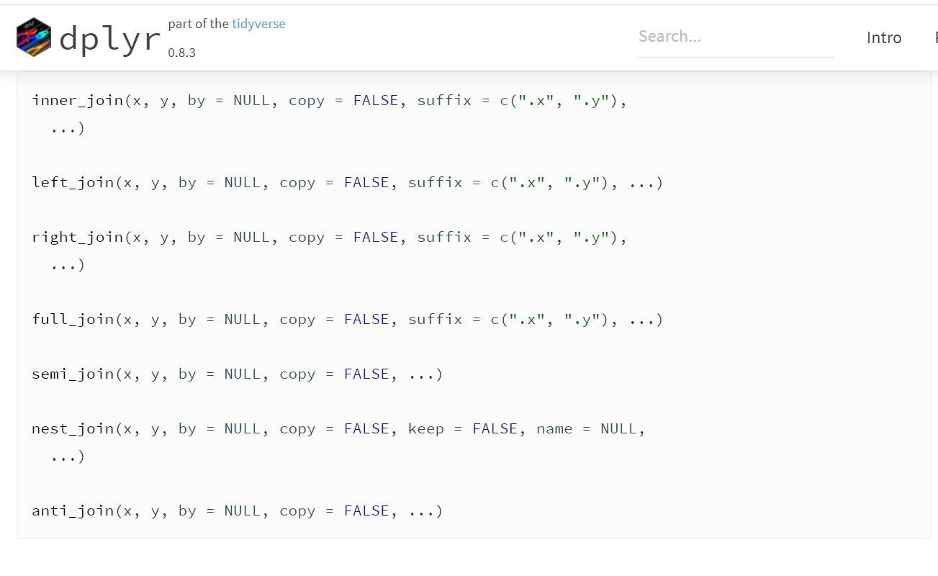
Join and Union with R

Slide 33
Joins and Union with R
Read the data or generate it.
library(dplyr) tableA <- read.csv(".csv") tableB <- read.csv(".csv")
R script

